Slide 1
Prioritizing Cycle Infrastructure Based on Potential Demand
I use Manchester as an example But The analysis Is automated to run on any city in the UK

Slide 2
What Is The Current Mode Share?

Slide 4
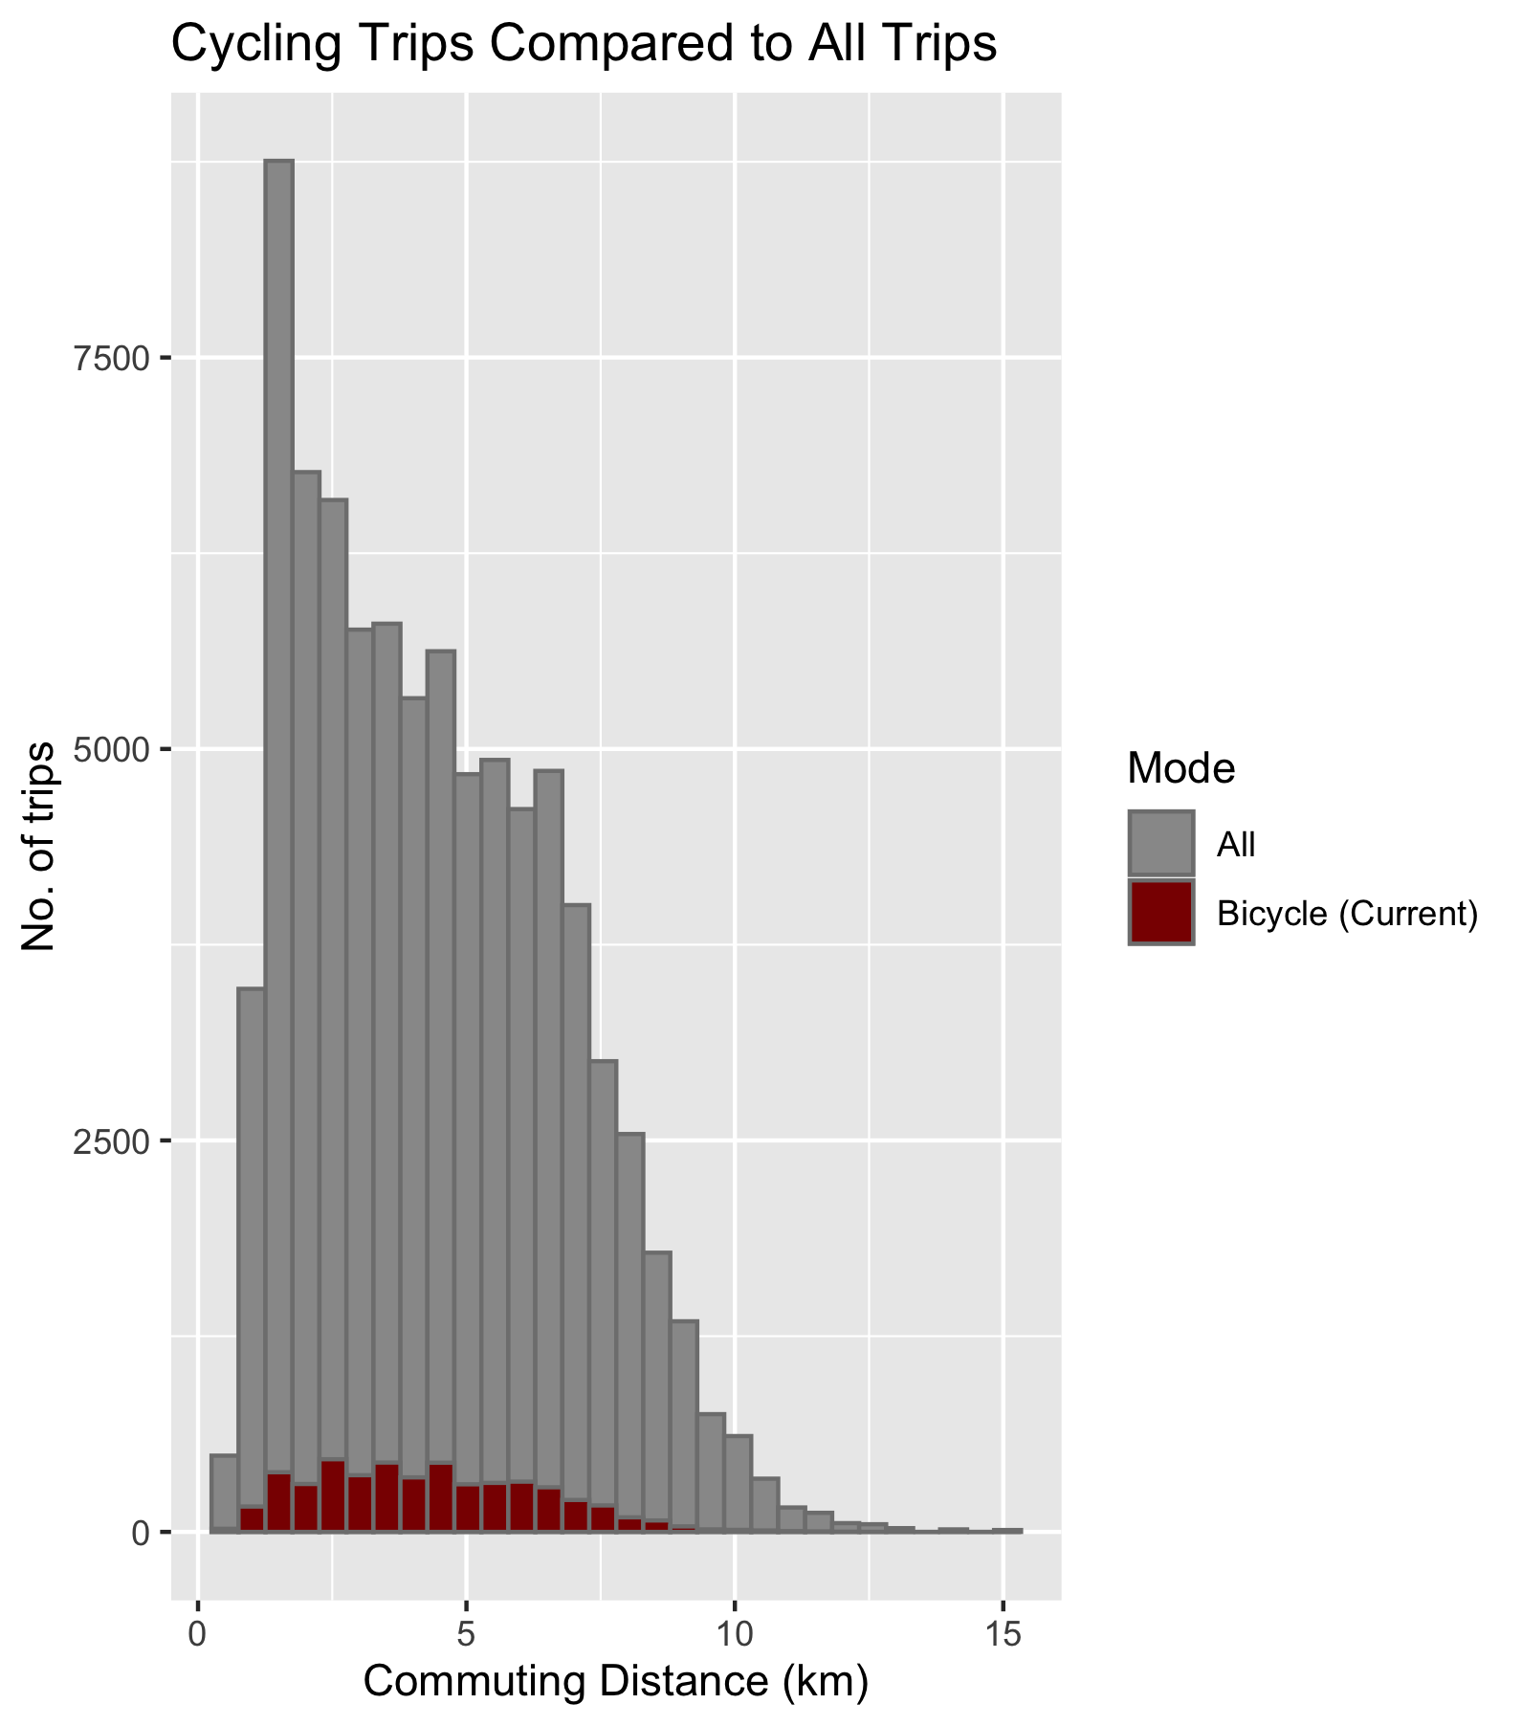
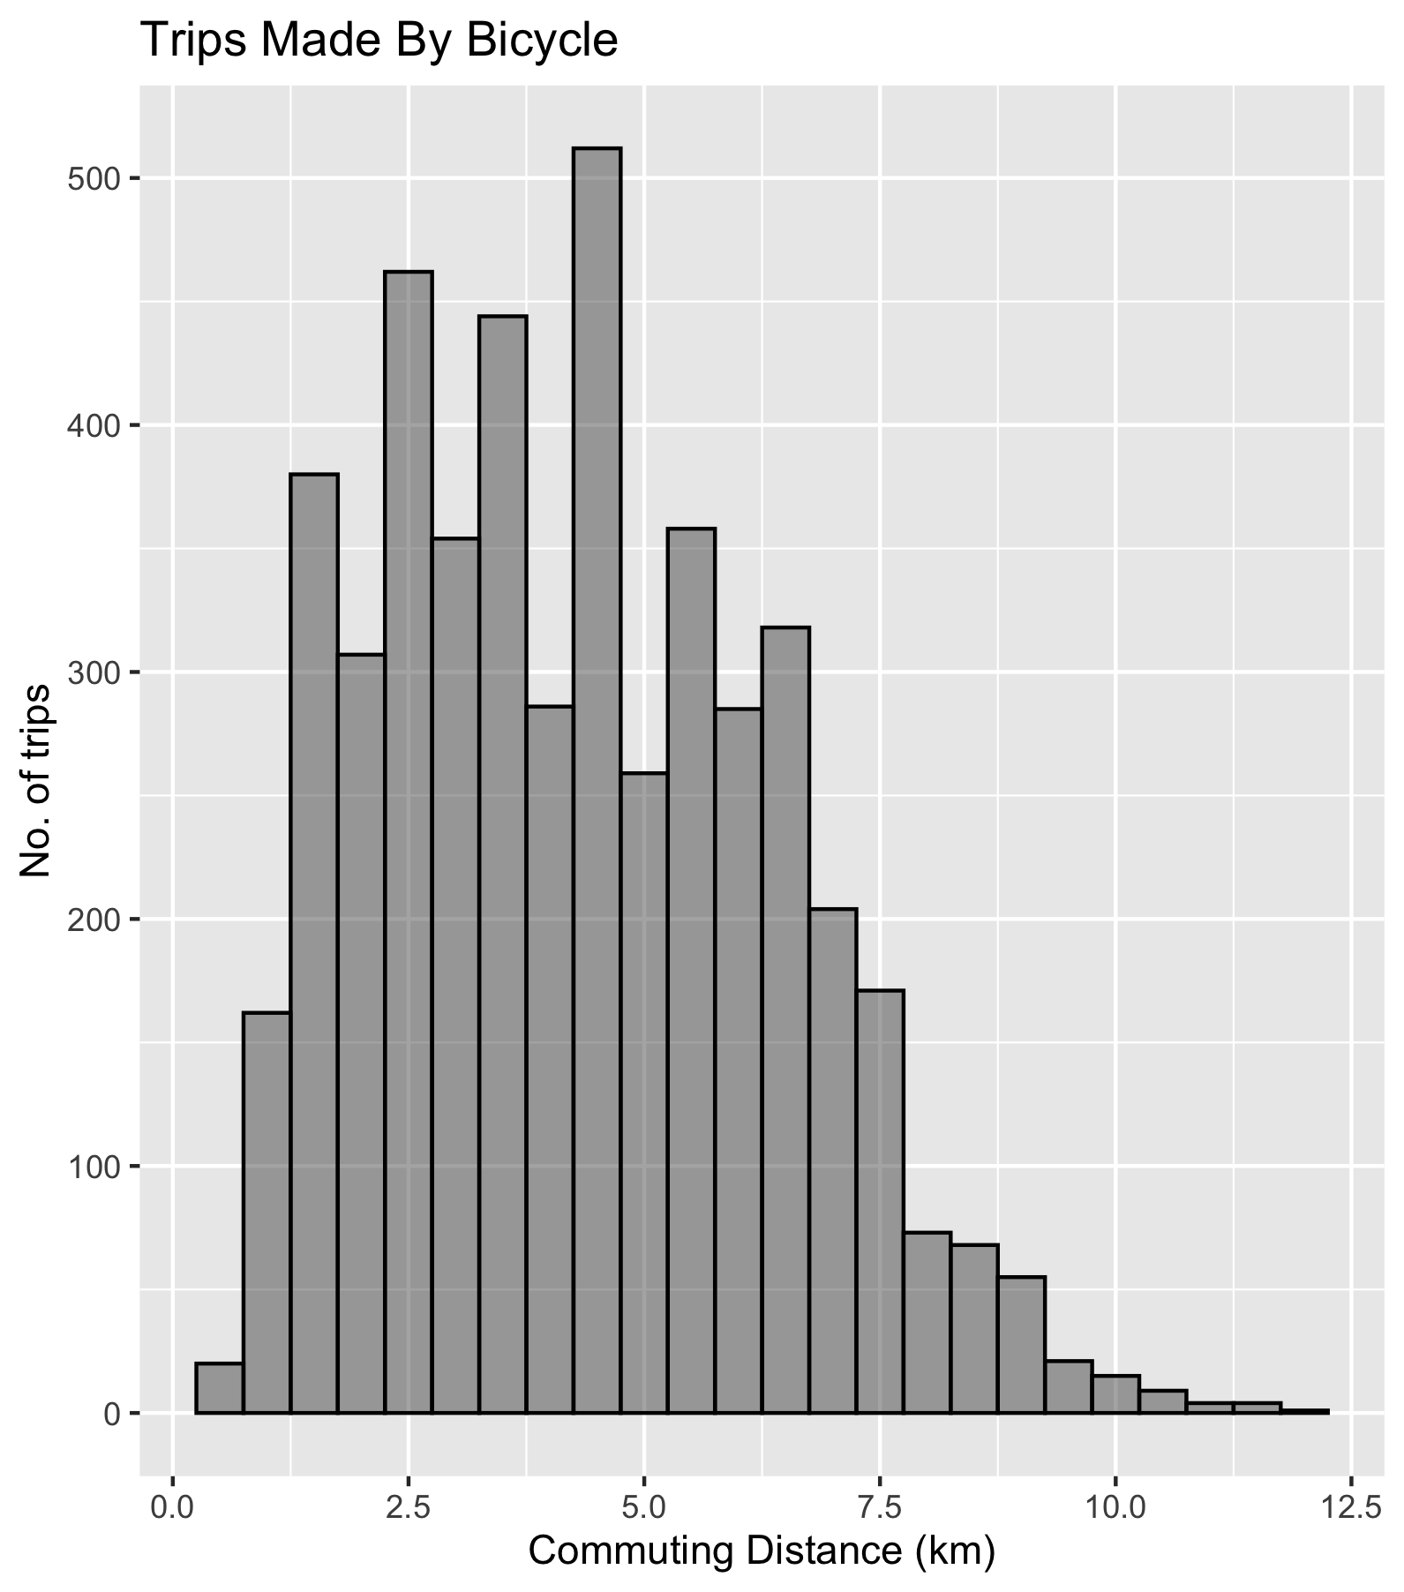

Slide 5
Let’s Look at Cycling Mode Share: How Are Different OD Pairs Performing Relative to the Average Flow for Their Distance?
Ratio = Cycling Mode Share / Average Cycling Mode Share for Distance Group*
*OD pairs are bucketed into 1km groups (1-2km, 5-6km……)

Slide 6
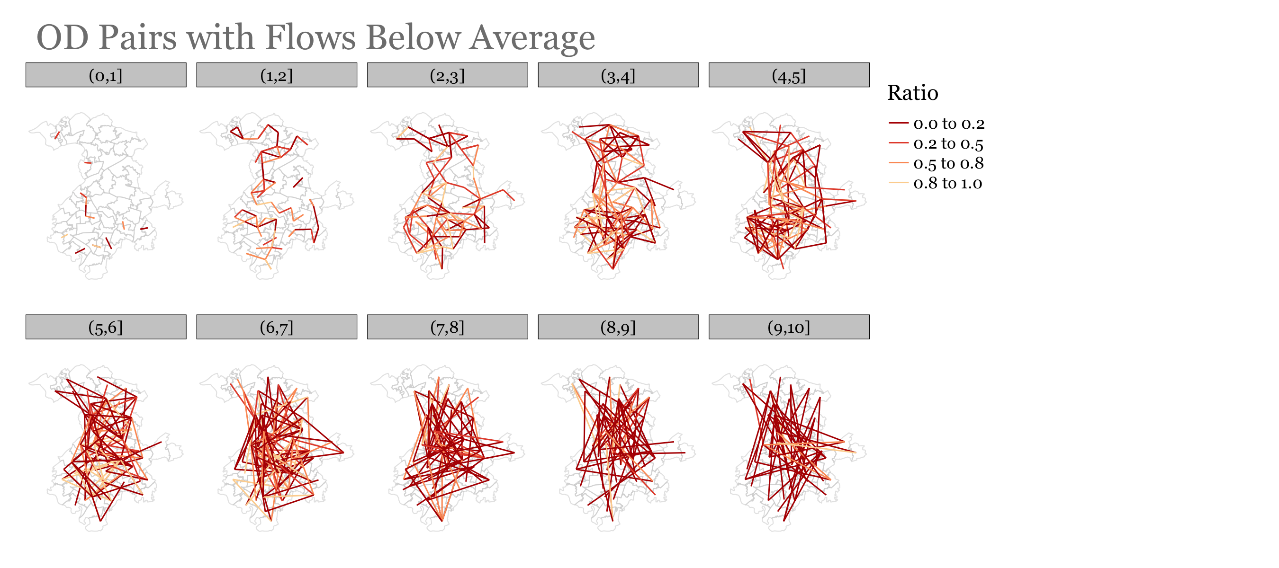

Slide 7
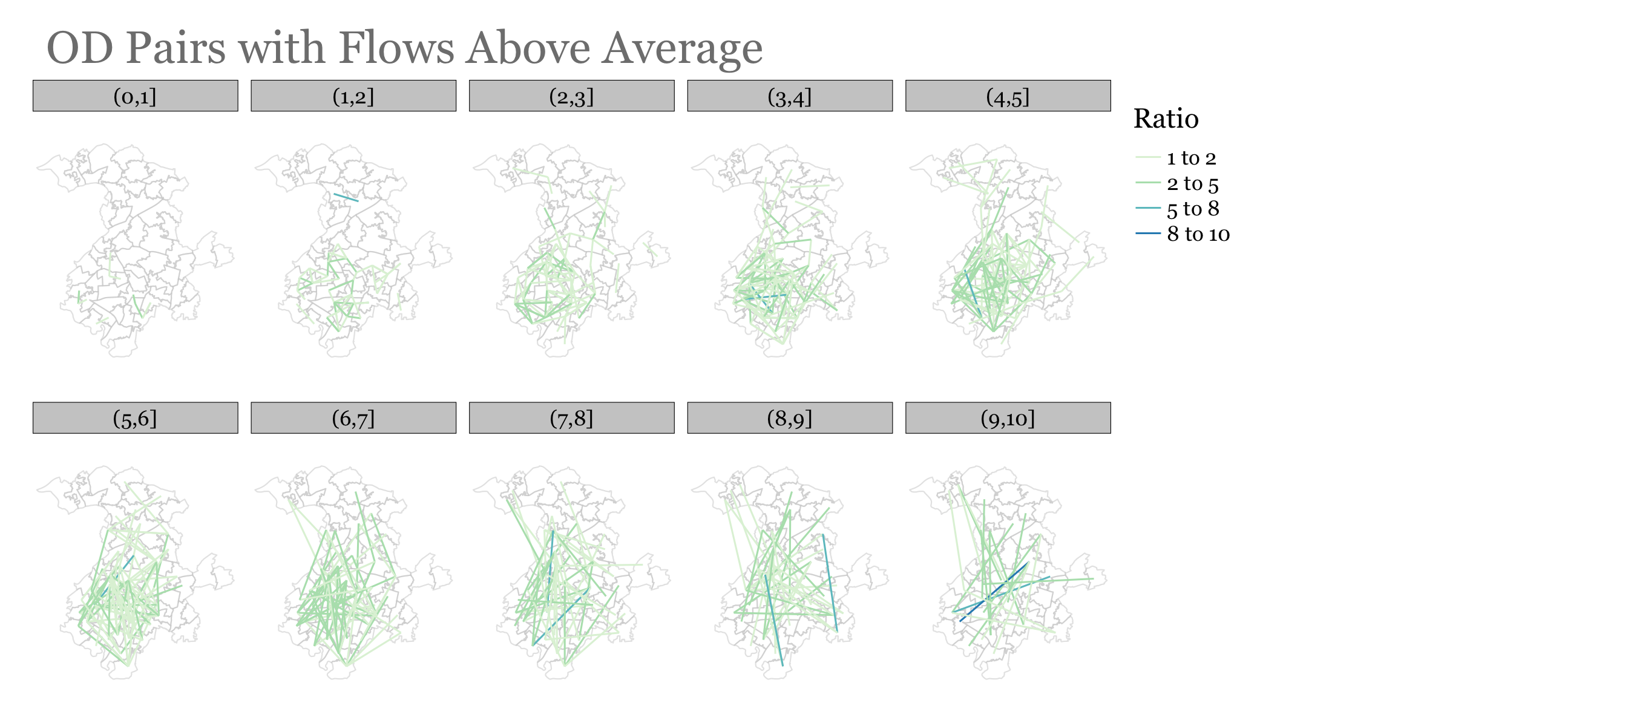

Slide 9
How Would An Increase In Cycling Mode Share Be Distributed Between The Different OD Pairs?

Slide 10
How to Distribute Additional Cycling Mode Share
We cannot increase the mode share for each OD by the same X%
We use a distance decay function:
Cycling Increase -> f(distance, slope)
Next slides show how a 15% increase in cycling mode share would be distributed. The new cycling mode share is referred to as ‘potential’

Slide 11
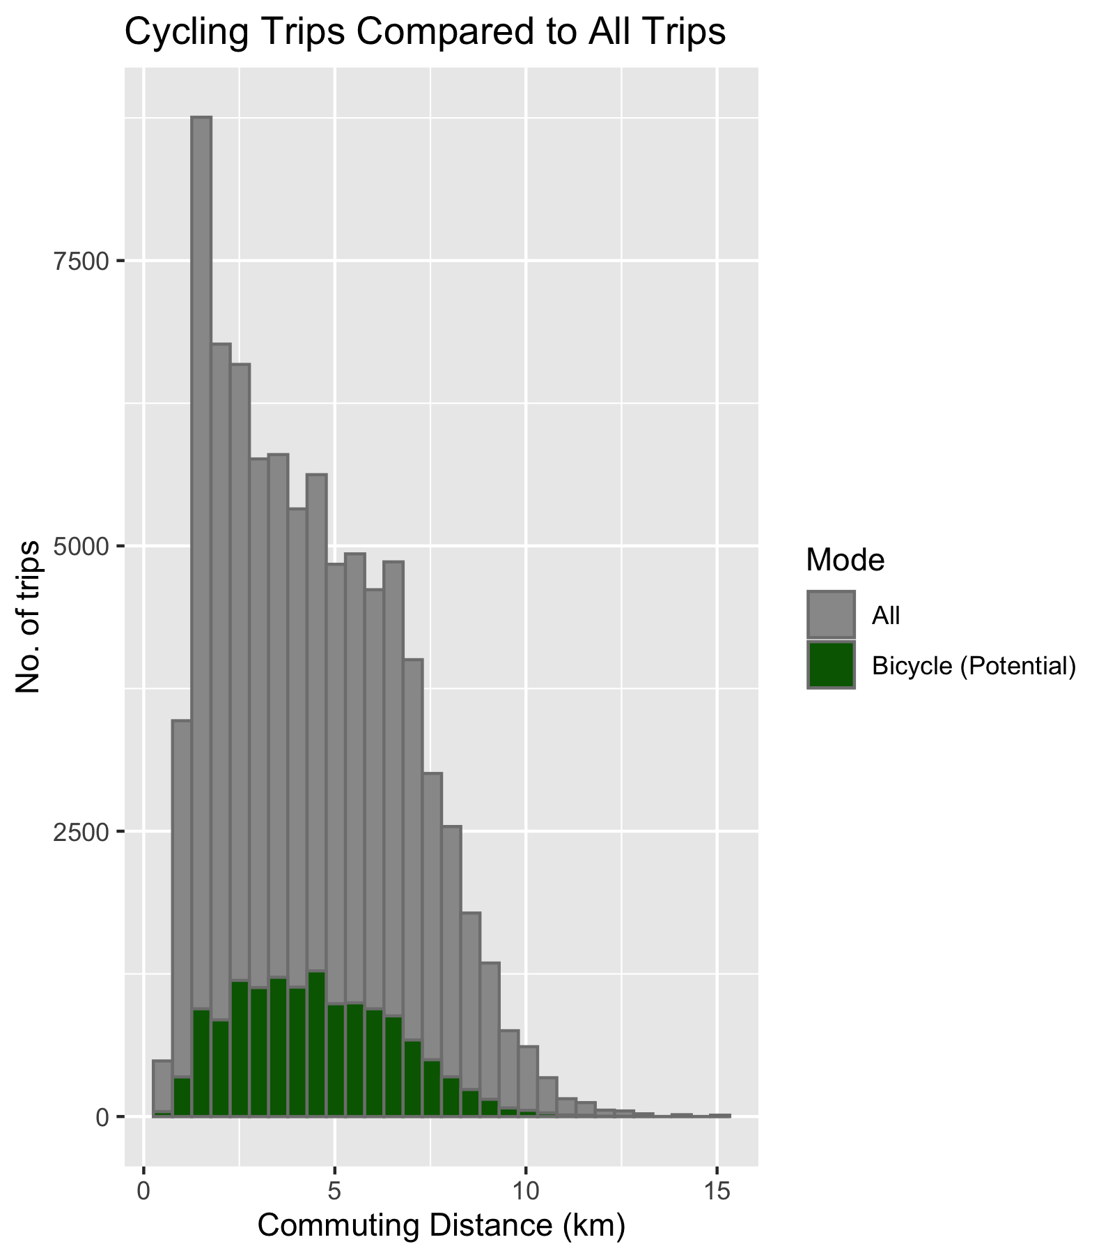

Slide 12
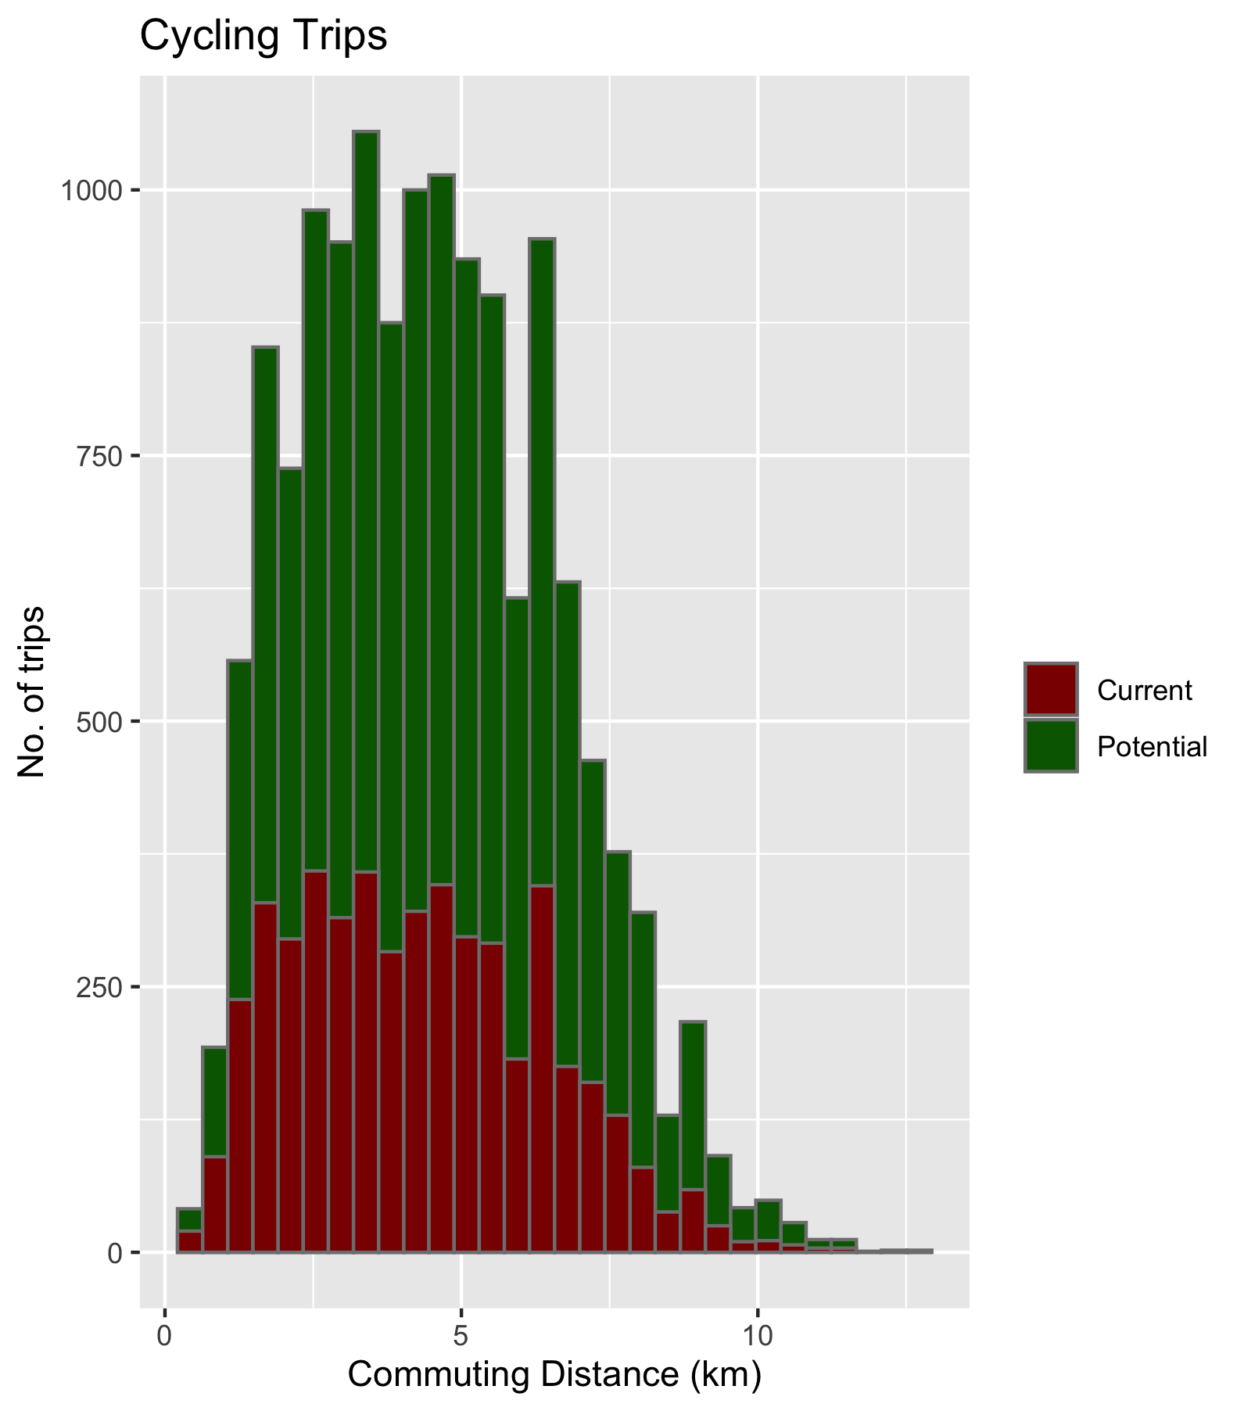
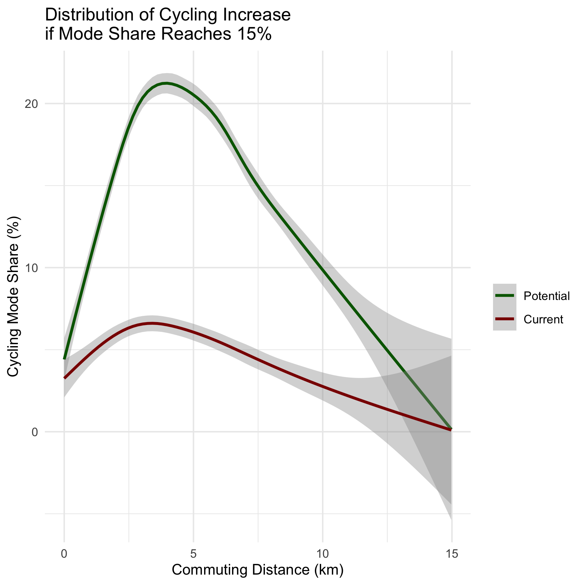

Slide 13
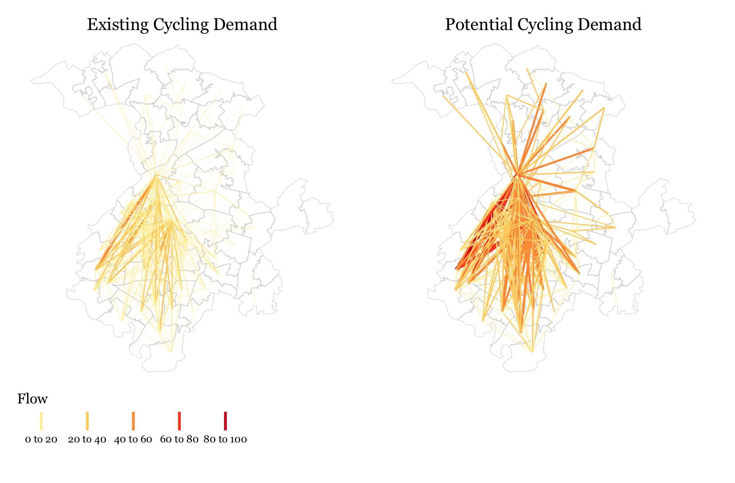

Slide 14
How Do We Route The Flows?

Slide 15
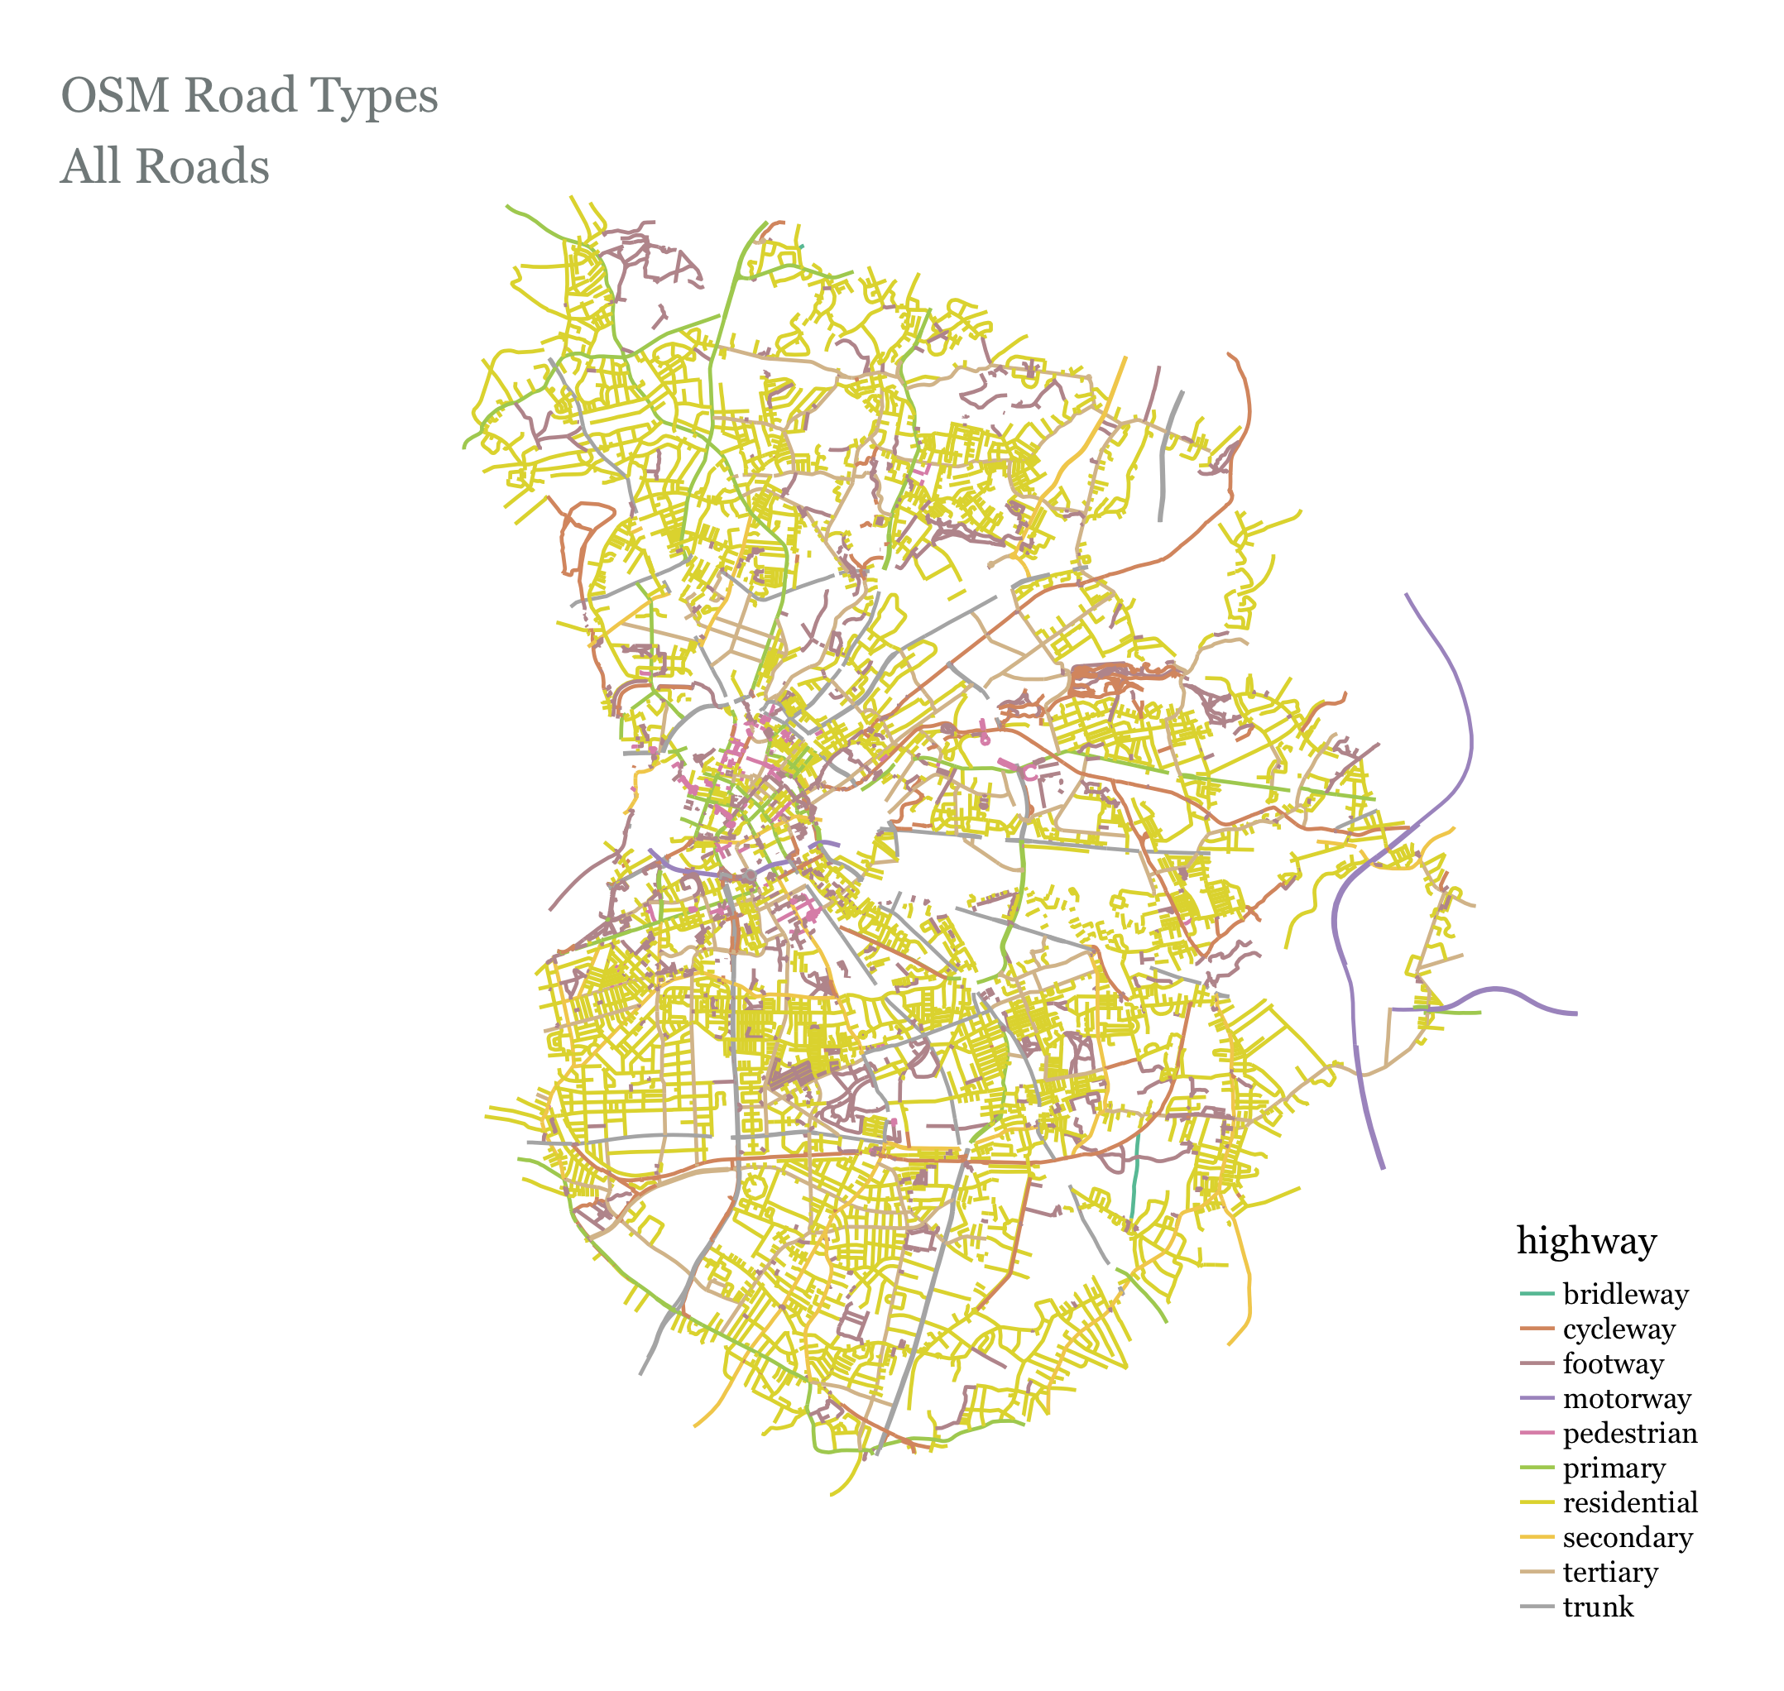

Slide 16
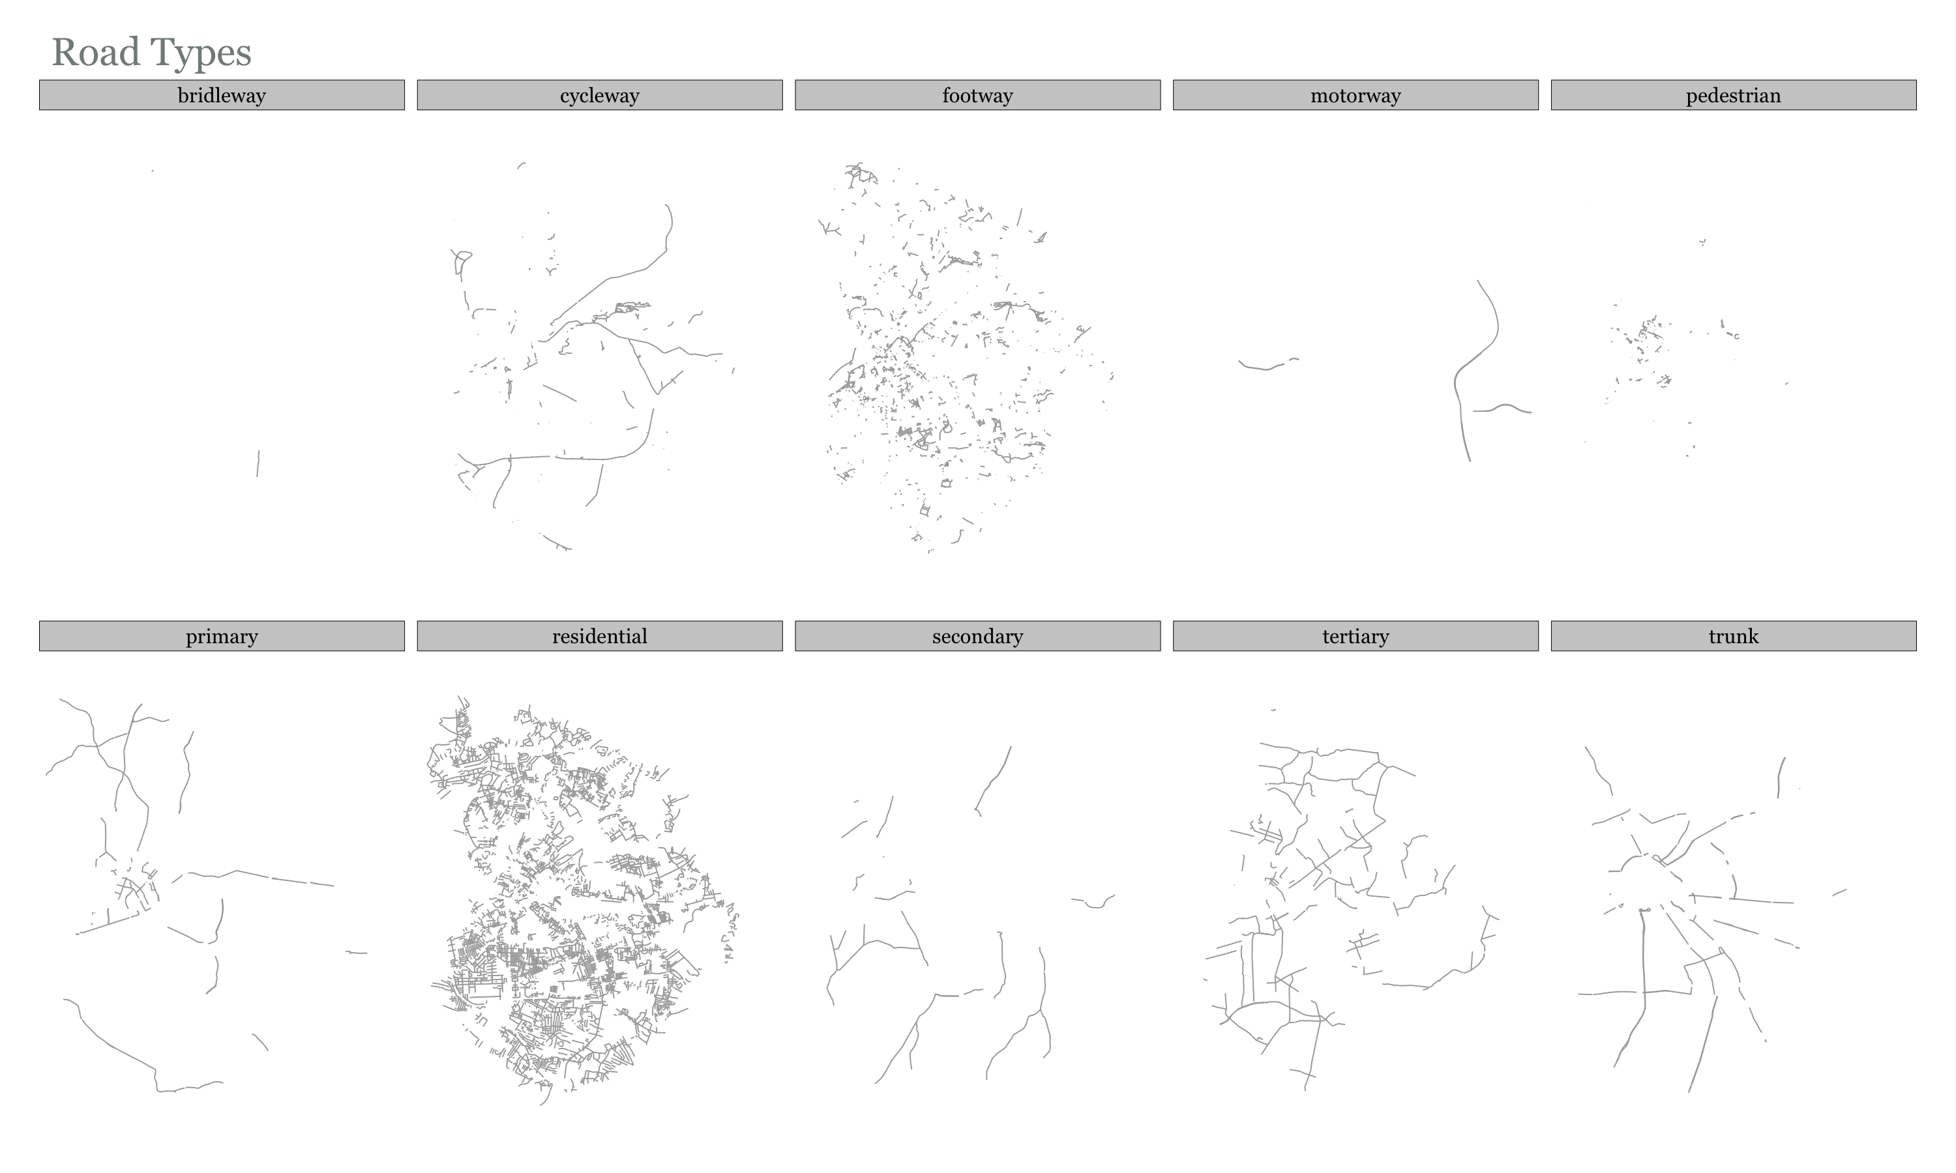

Slide 17
Routing Flows – Weighting Profiles
Highway Type | 1. Default (from routino) | 2. Reduced Impedence on Trunk Roads | 3. Unweighted Shortest Paths (All roads equal)
motorway | 0 | ‘’ ‘’ ‘’ | 1
trunk | 0.3 | 0.7 | 1
primary | 0.7 | ‘’ ‘’ ‘’ | 1
secondary | 0.8 | ‘’ ‘’ ‘’ | 1
tertiary | 0.9 | ‘’ ‘’ ‘’ | 1
unclassified | 0.9 | ‘’ ‘’ ‘’ | 1
residential | 0.9 | ‘’ ‘’ ‘’ | 1
service | 0.9 | ‘’ ‘’ ‘’ | 1
track | 0.9 | ‘’ ‘’ ‘’ | 1
cycleway | 1 | ‘’ ‘’ ‘’ | 1
path | 0.9 | ‘’ ‘’ ‘’ | 1
steps | 0 | ‘’ ‘’ ‘’ | 1
ferry | 0.2 | ‘’ ‘’ ‘’ | 1
Notes:
the value is the % of commuters/flow that will choose that road type

Slide 18
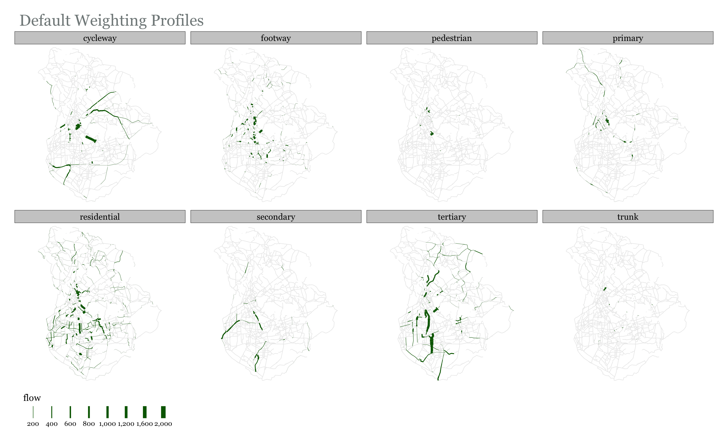

Slide 19
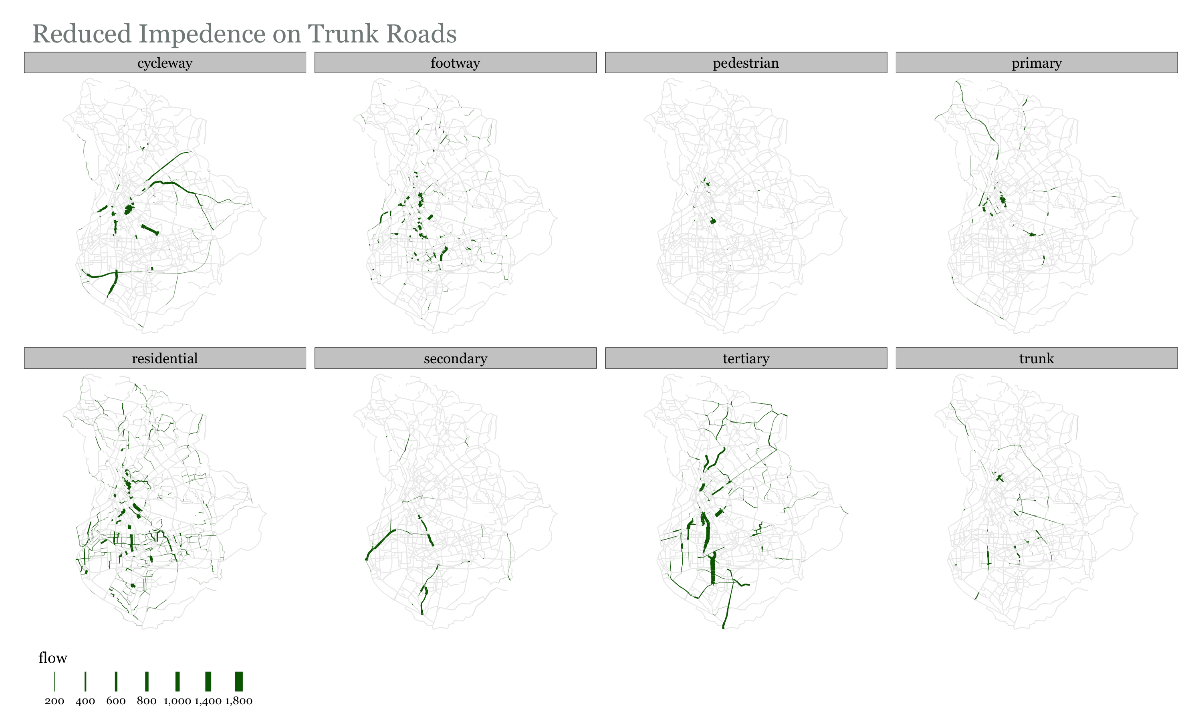

Slide 20
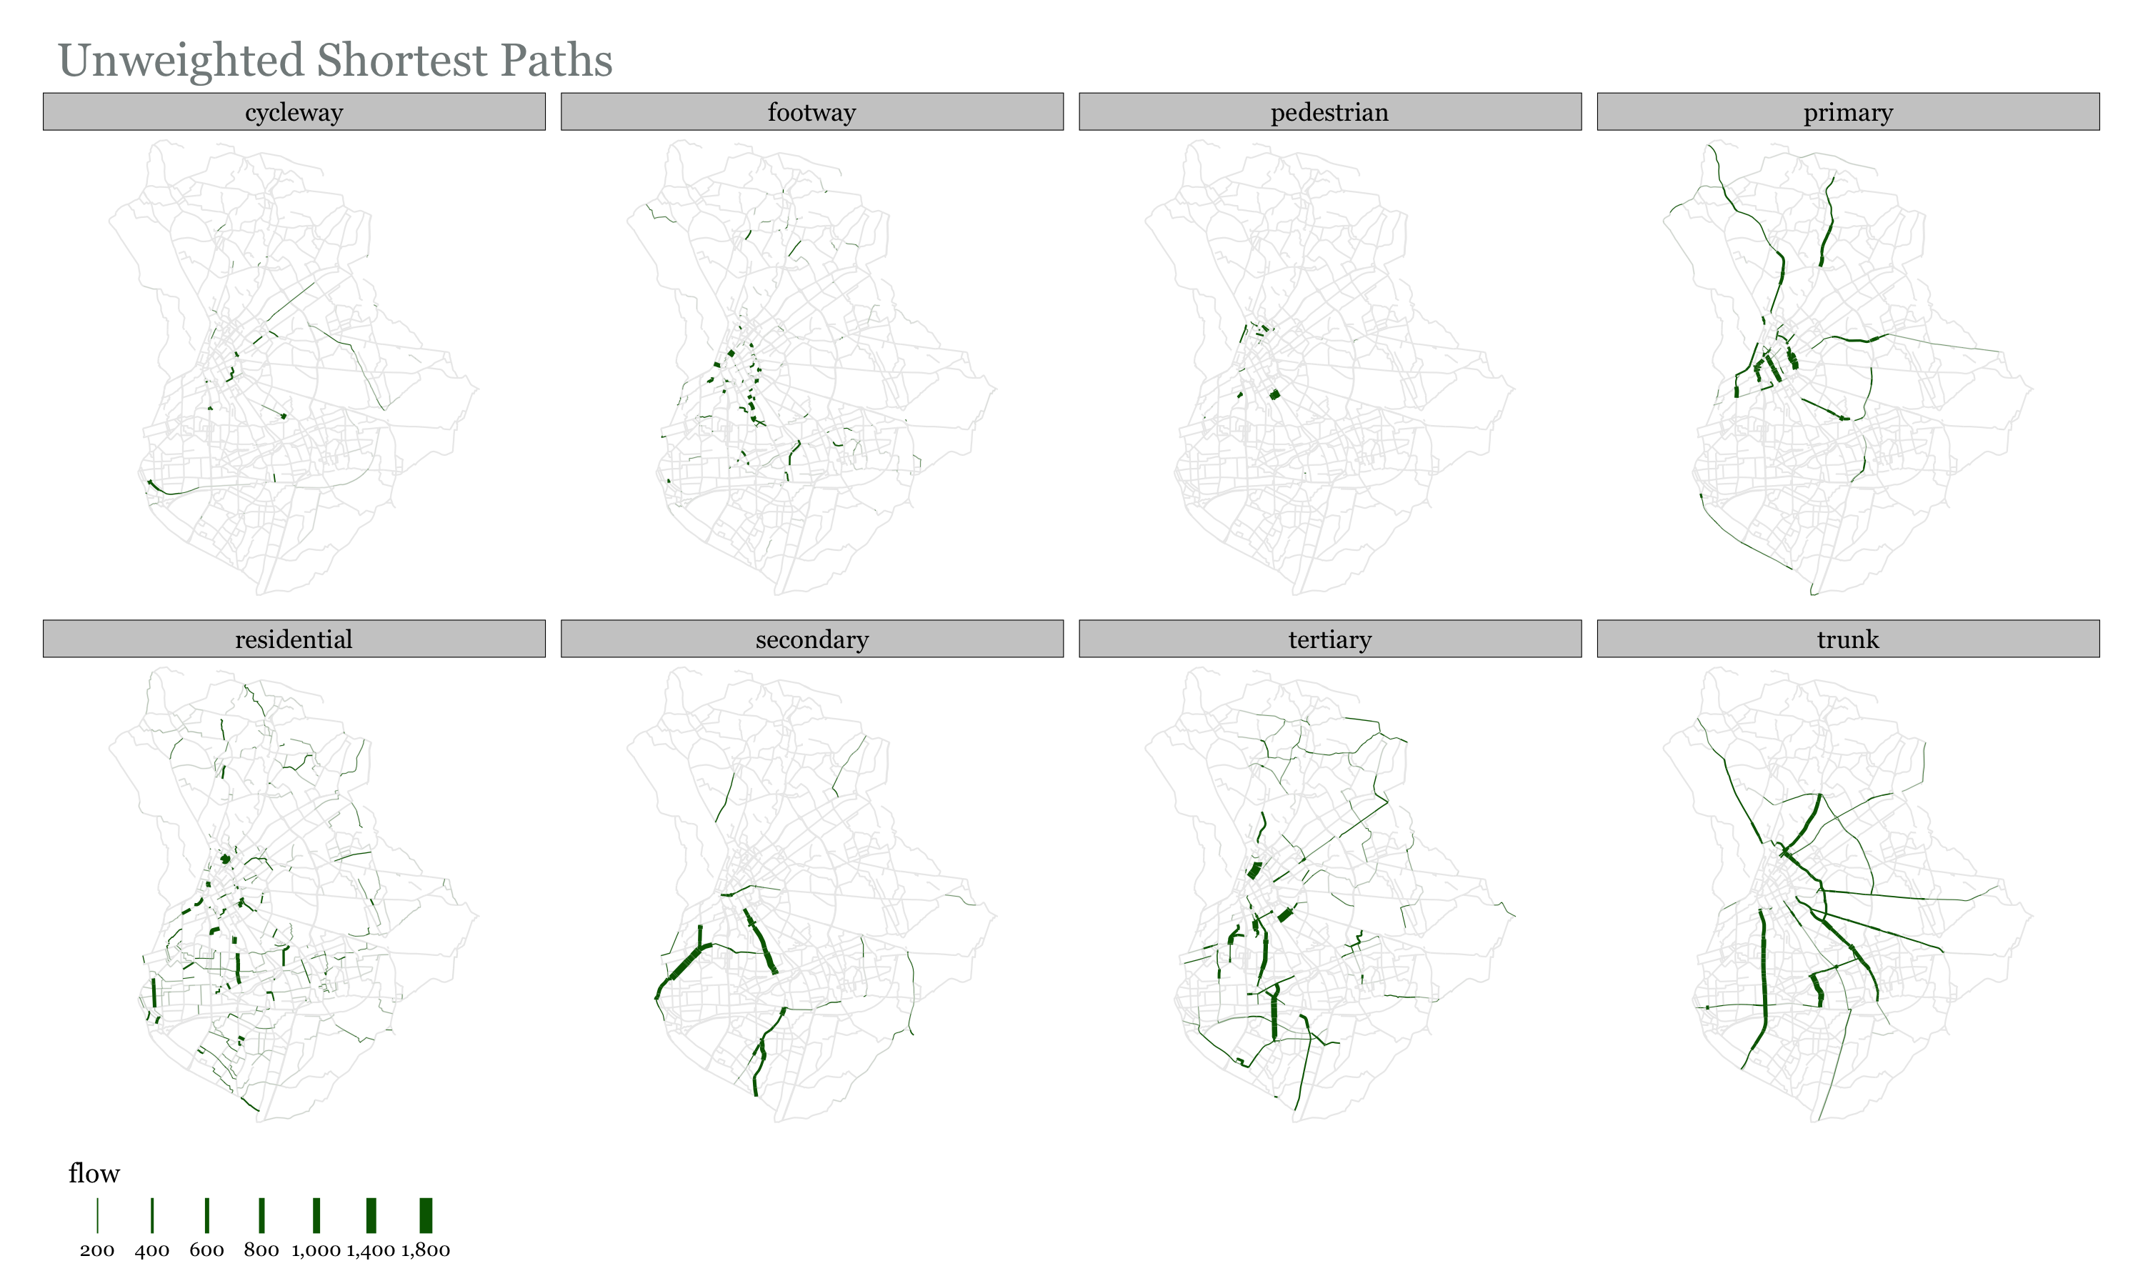

Slide 21
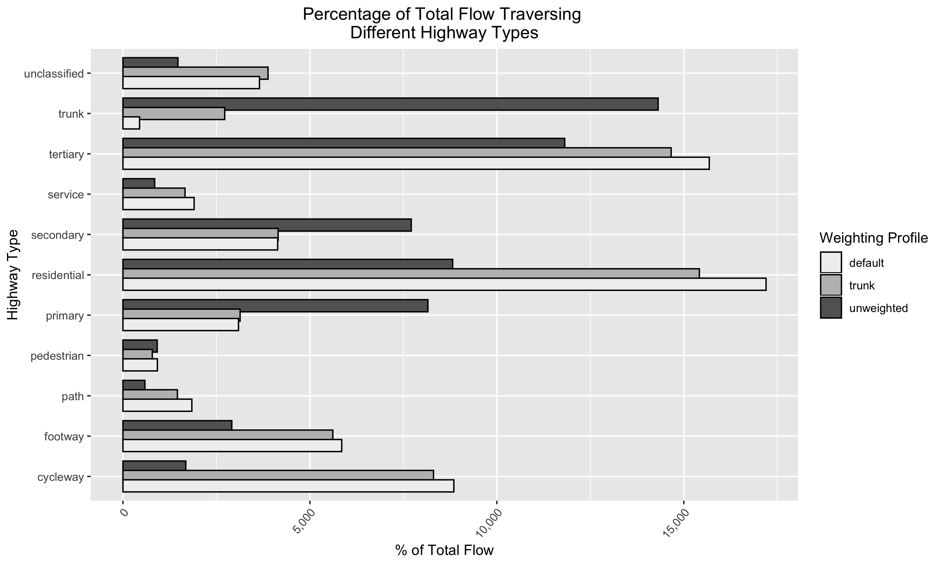

Slide 22
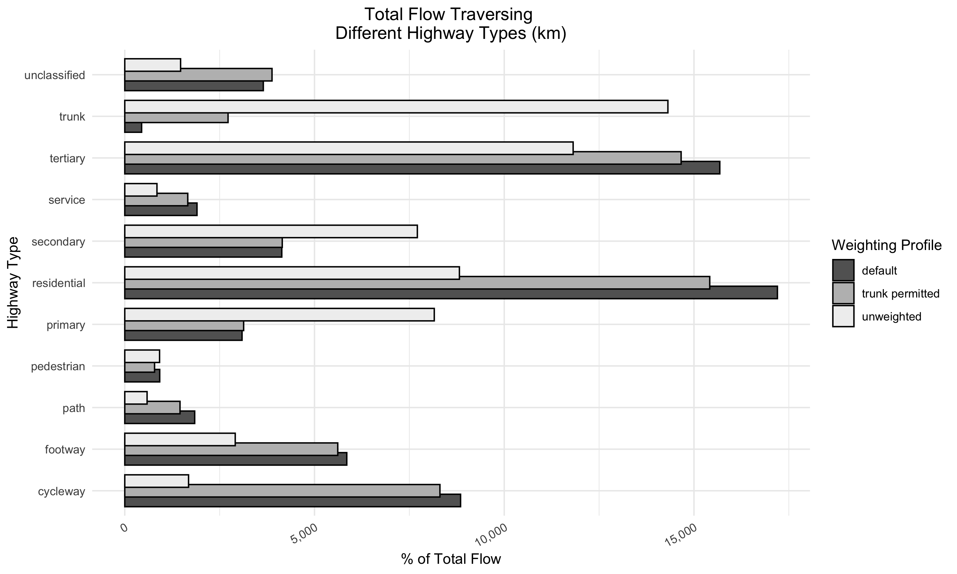

Slide 23
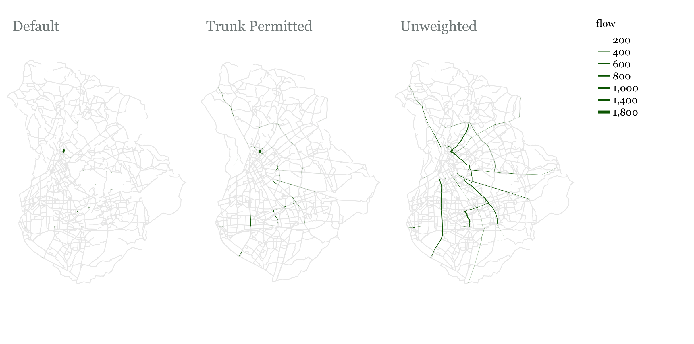
Flow on Trunk Roads

Slide 24
Growing A Network – One Seed
We aim for a connected network. We grow the network incrementally by selecting neighboring edges.
How to prioritize edges?
Flow passing through them: Higher is better
Person_km Satisfied: Edges have different lengths. Person_km satisfied accounts for that. It is equal to: Flow on edge * length of edge

Slide 25
Run the algorithm/s and add plots here

Slide 26
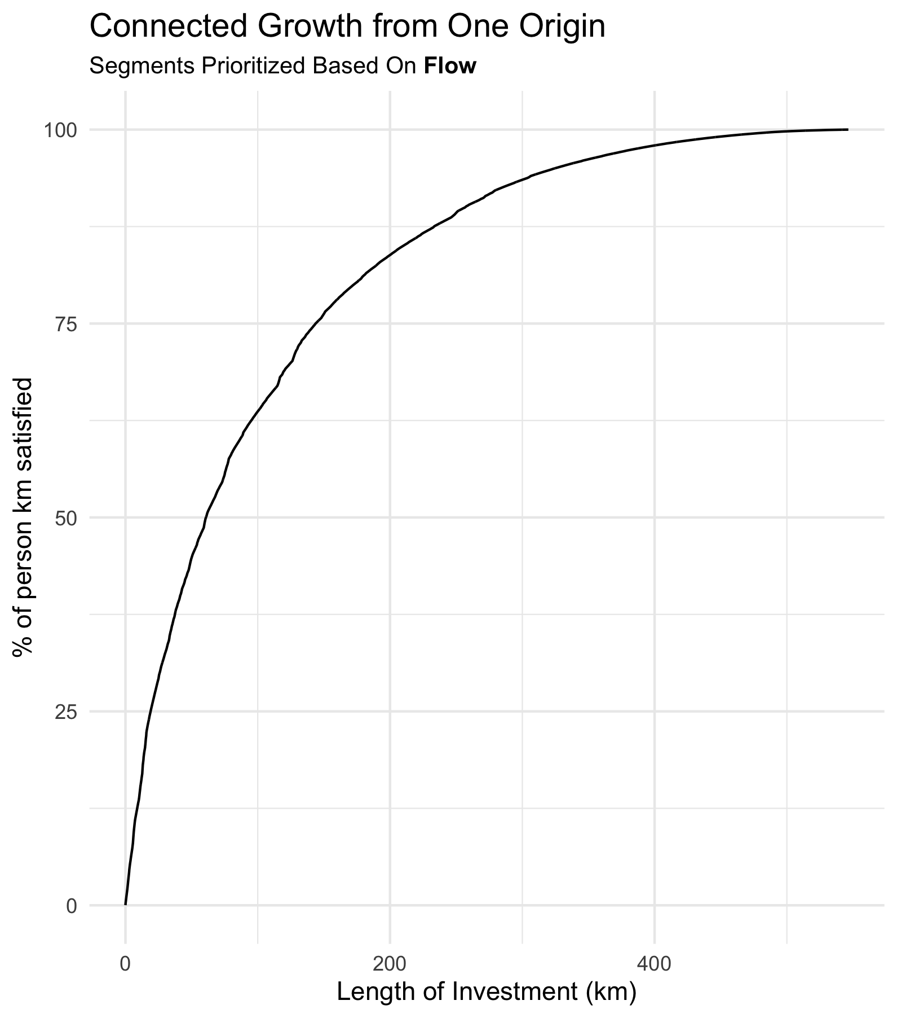
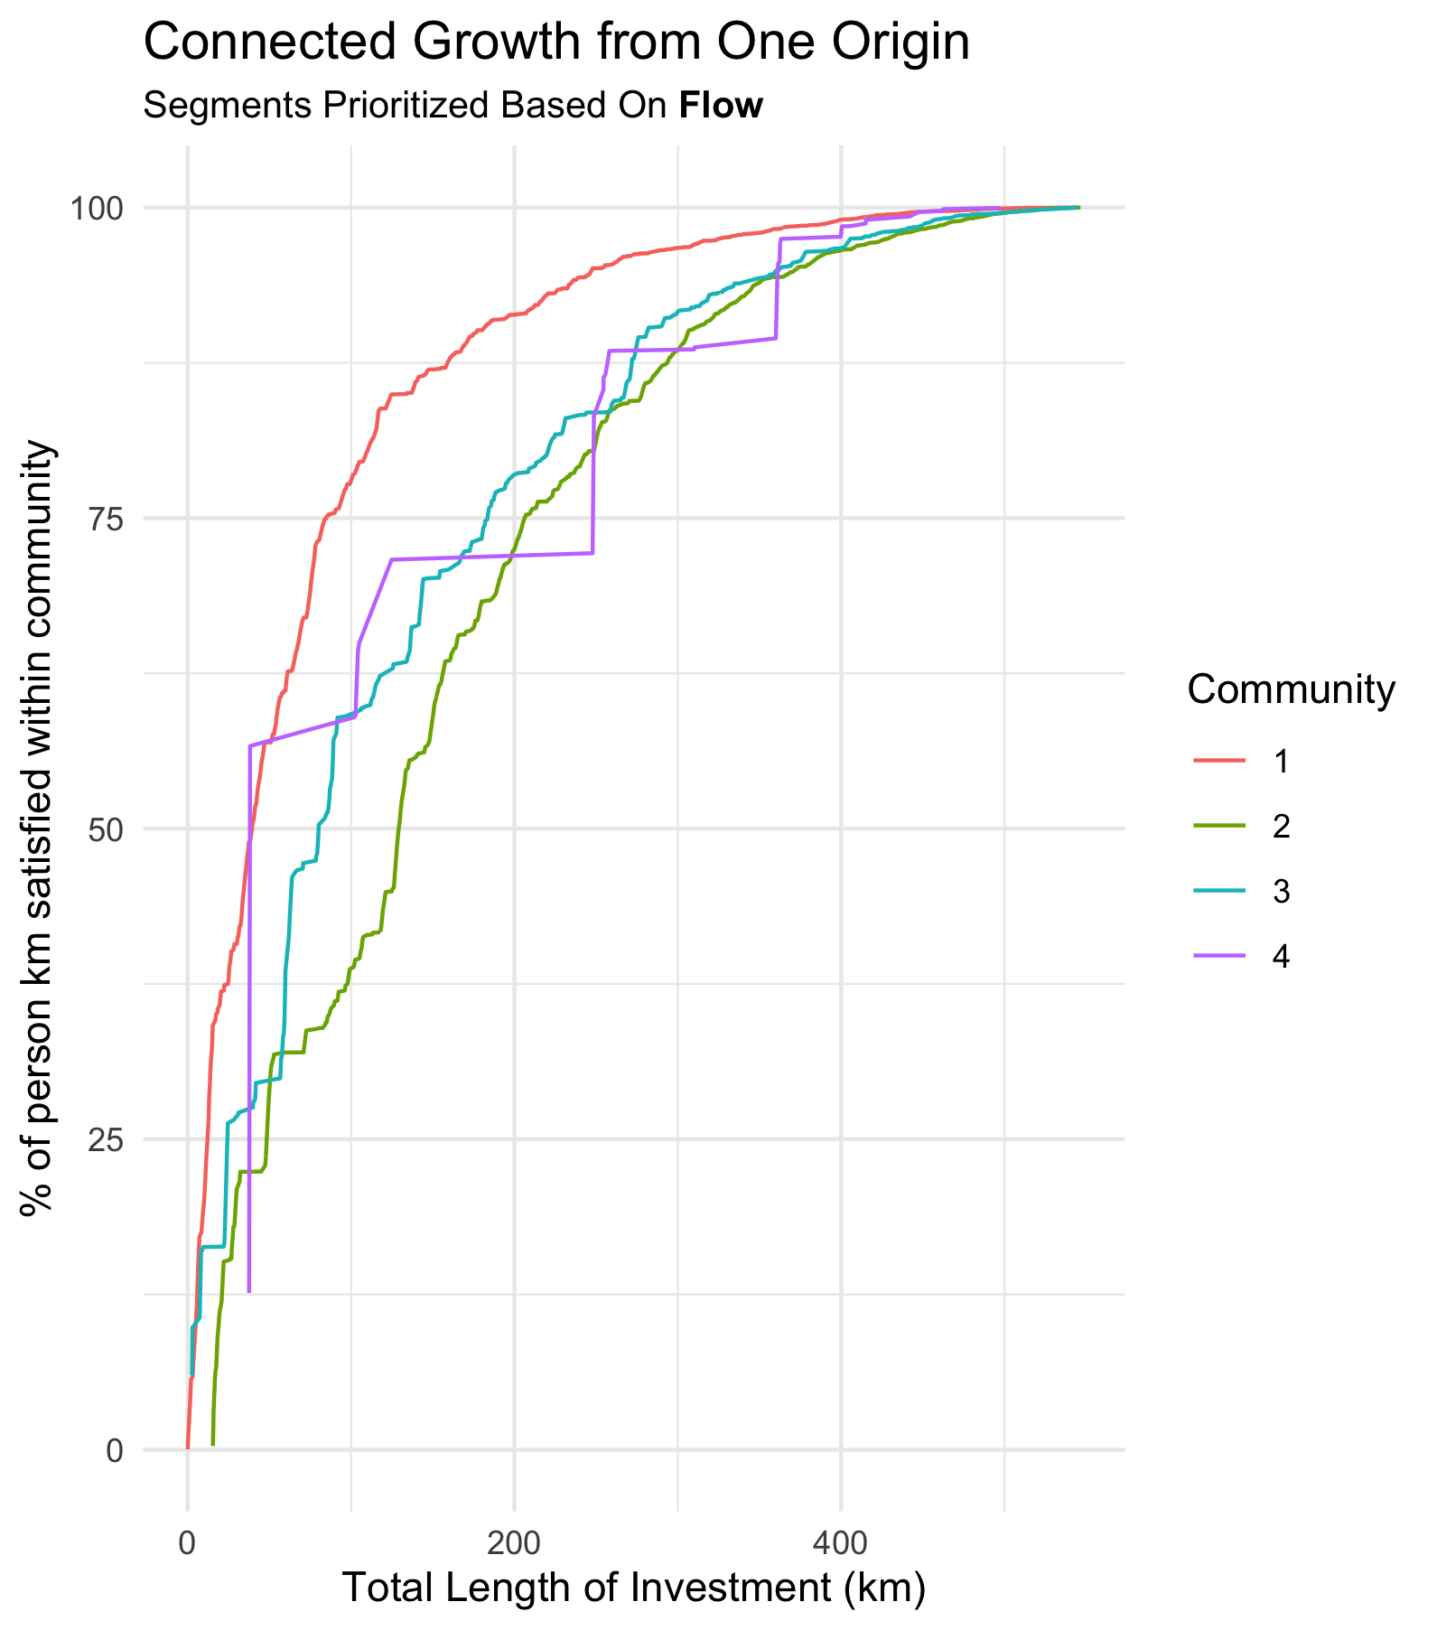

Slide 27
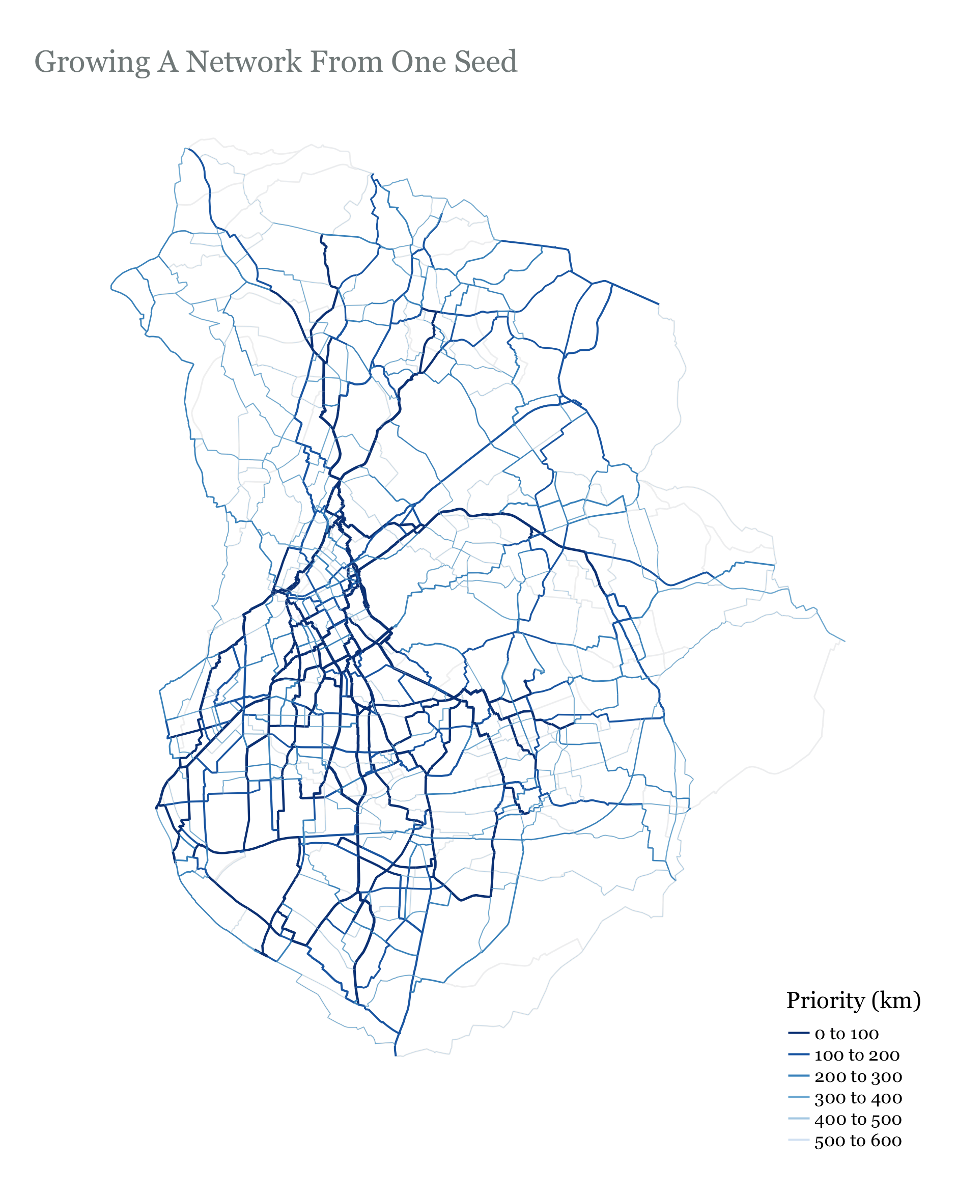

Slide 28
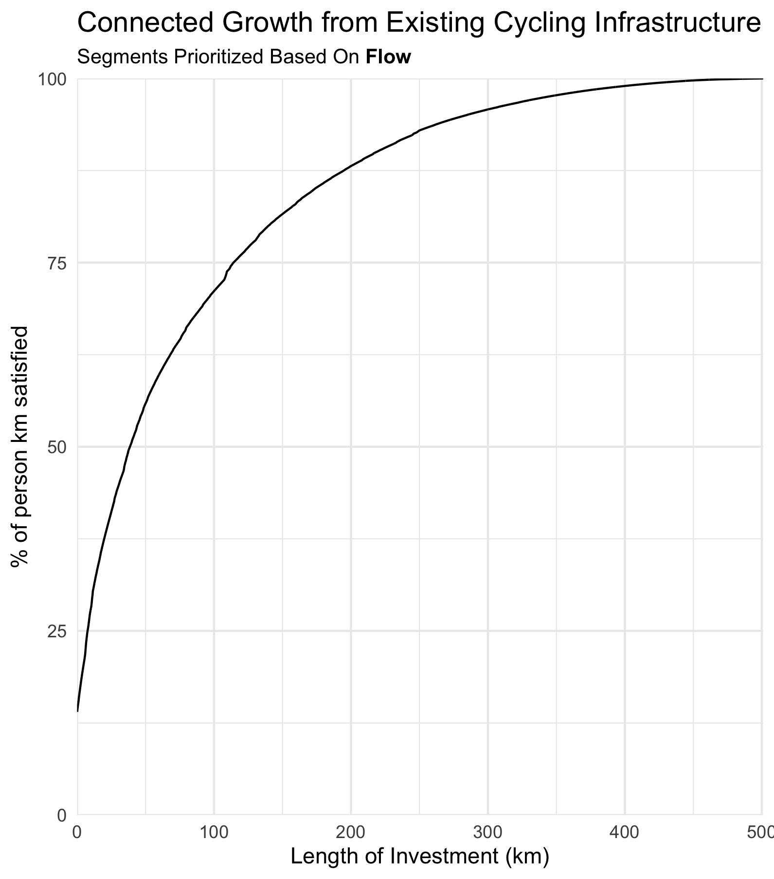
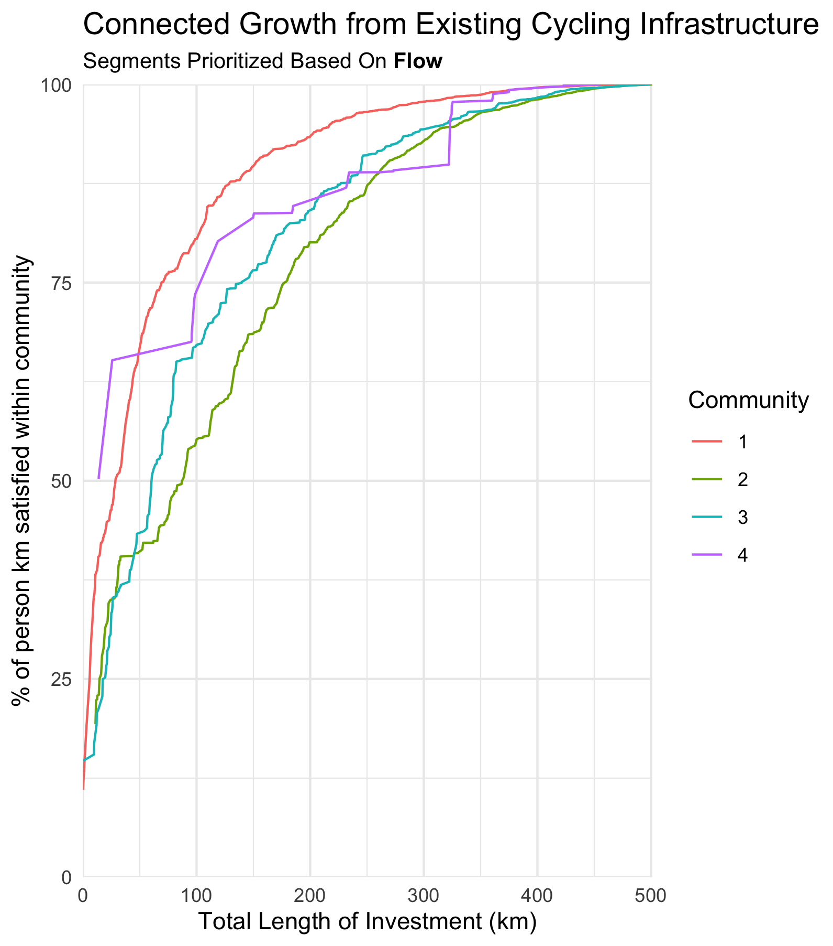
Connected Growth From Existing Infrastructure

Slide 29
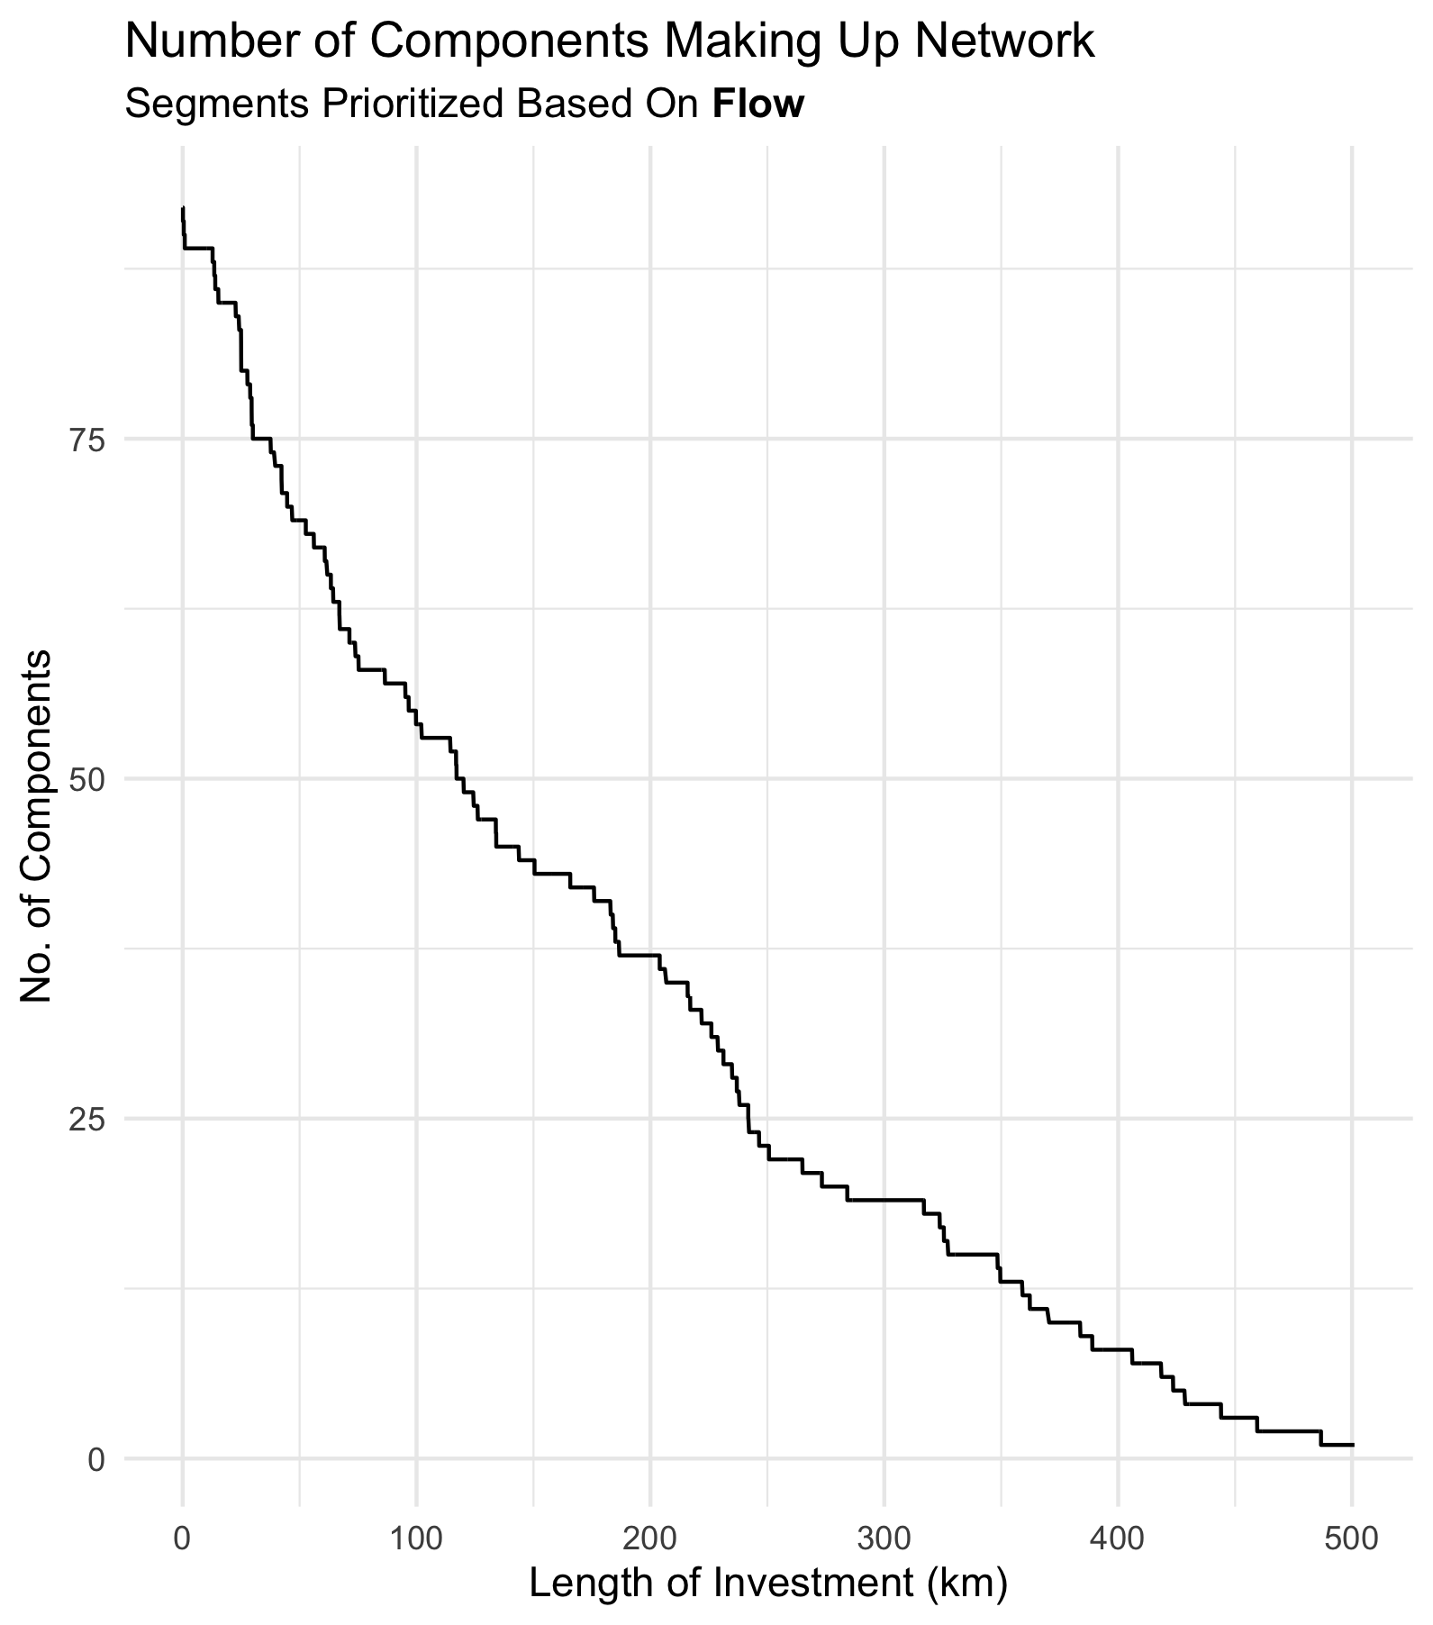
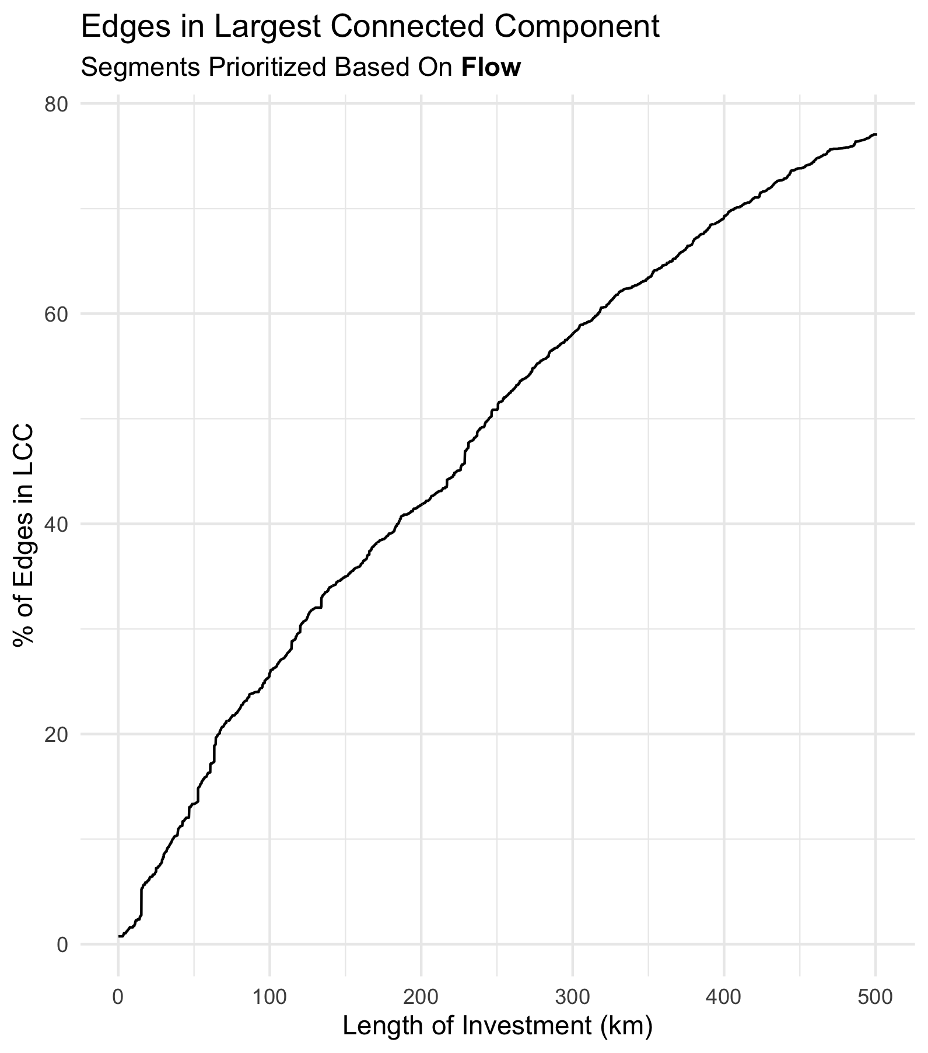

Slide 30
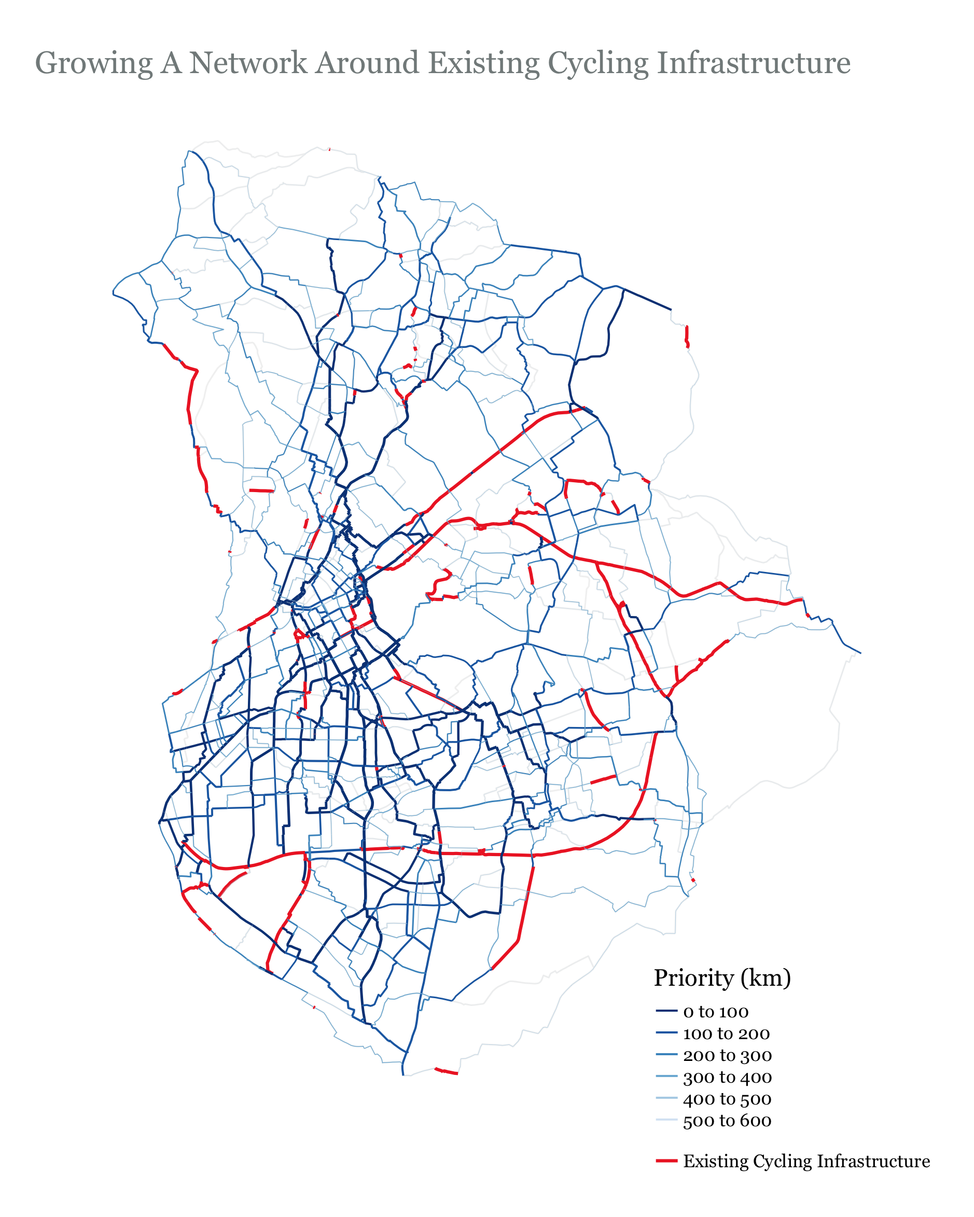

Slide 31
Growing A Network – Multiple Seeds
If we grow a network incrementally from one edge, we will not get proper distribution of investment. We want to start with multiple seeds. We can use community detection to achieve this

Slide 32
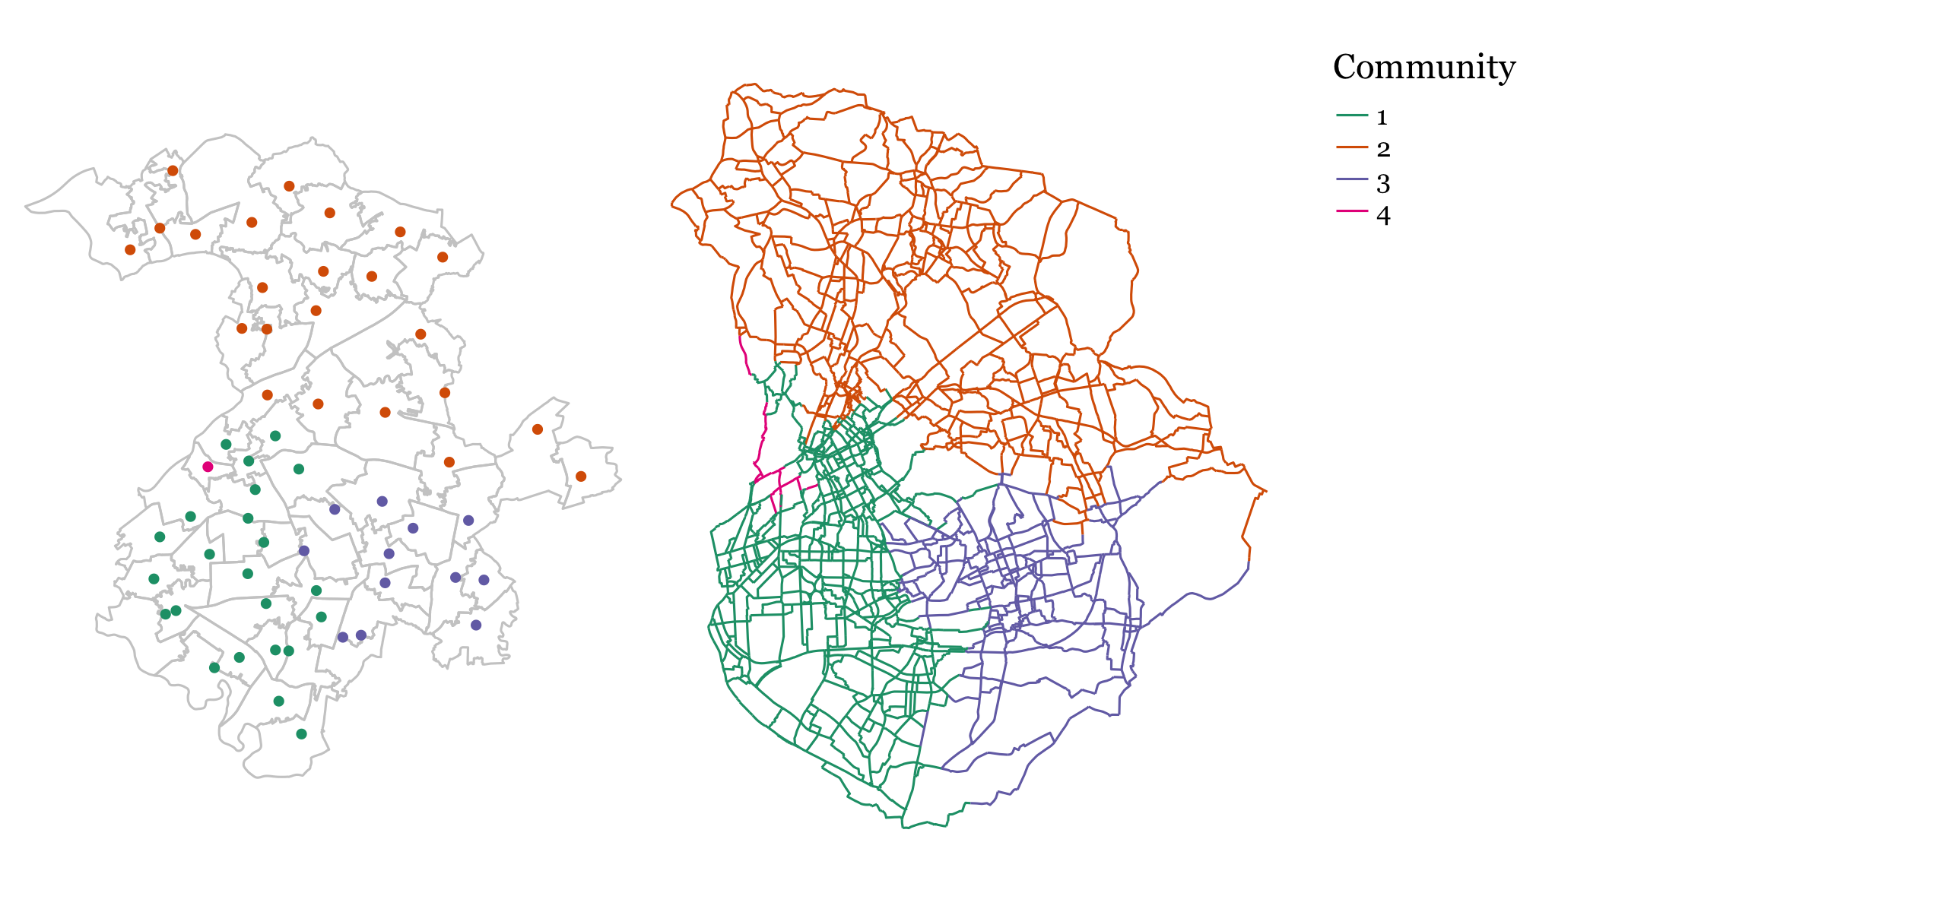
Communities –Louvian Algorithm
MSOAs assigned to communities based on potential flow between them
Edges assigned to communities based on their proximity to MSOA centroids

Slide 33
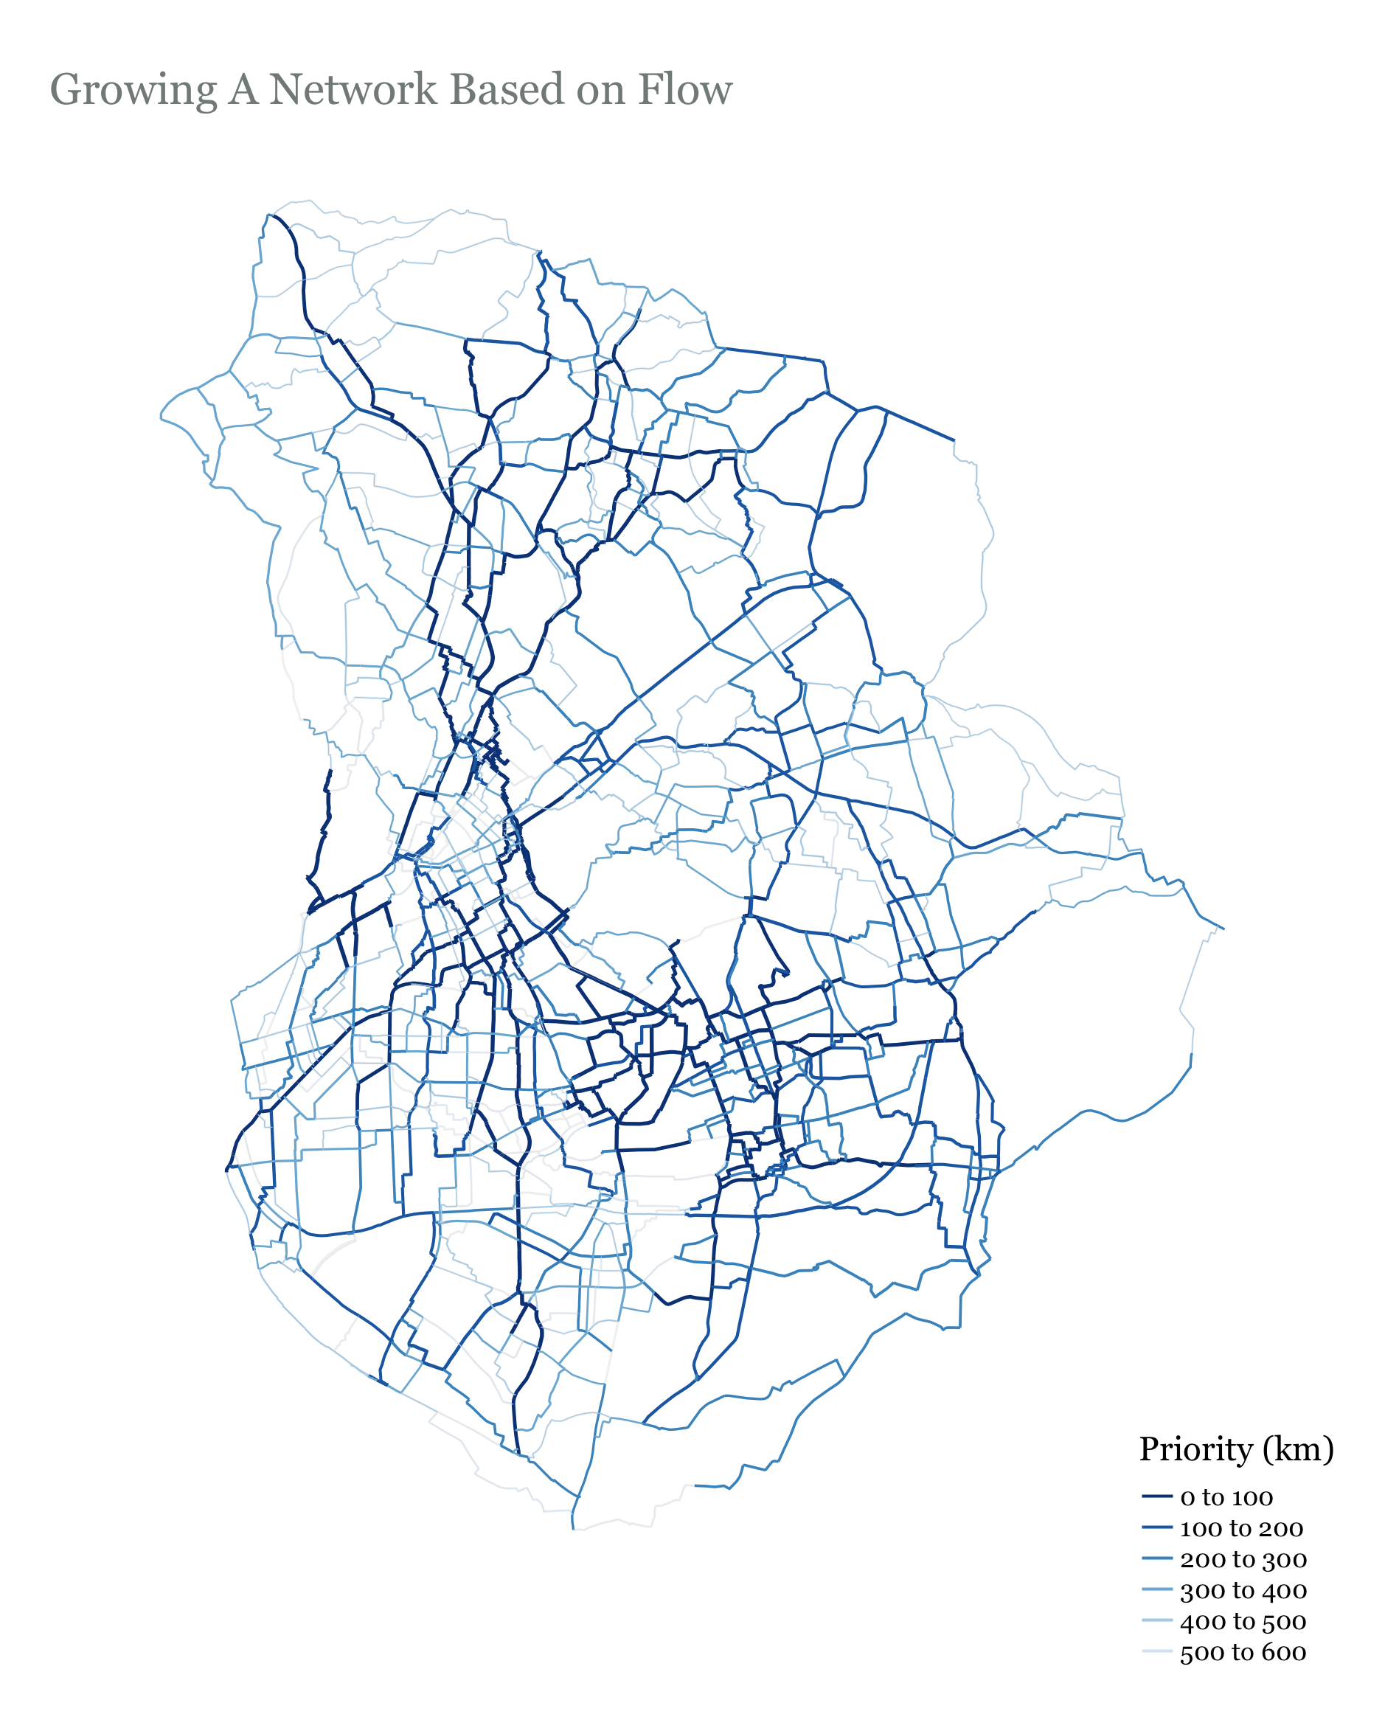
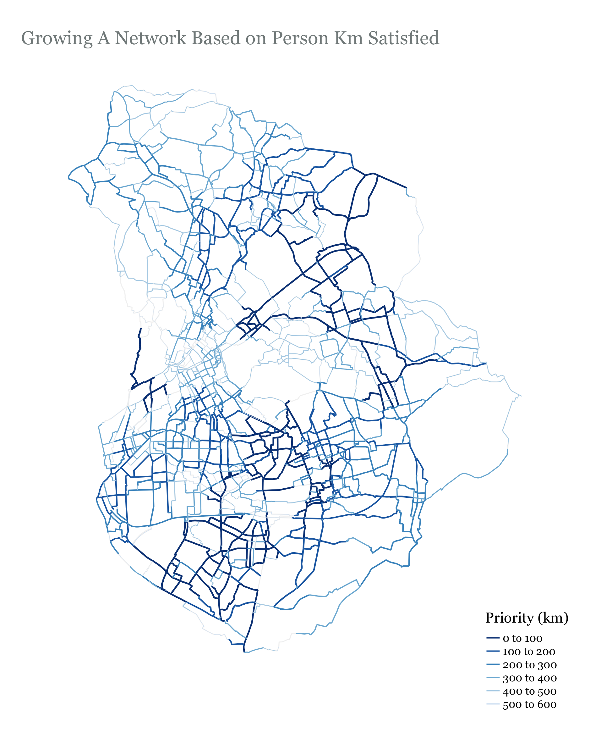

Slide 34
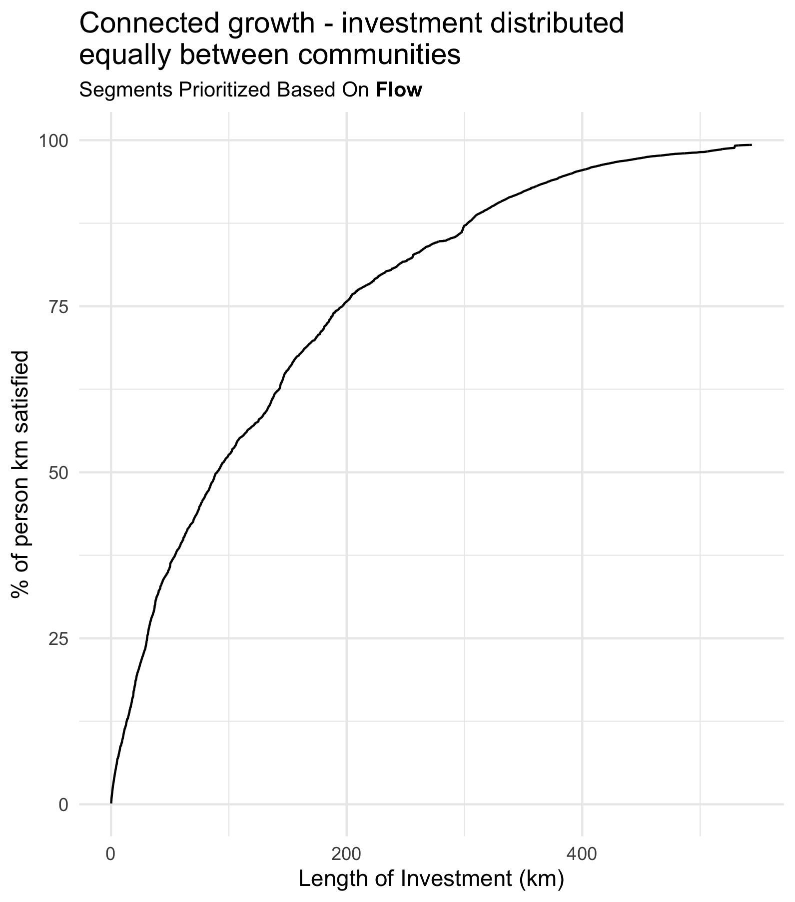
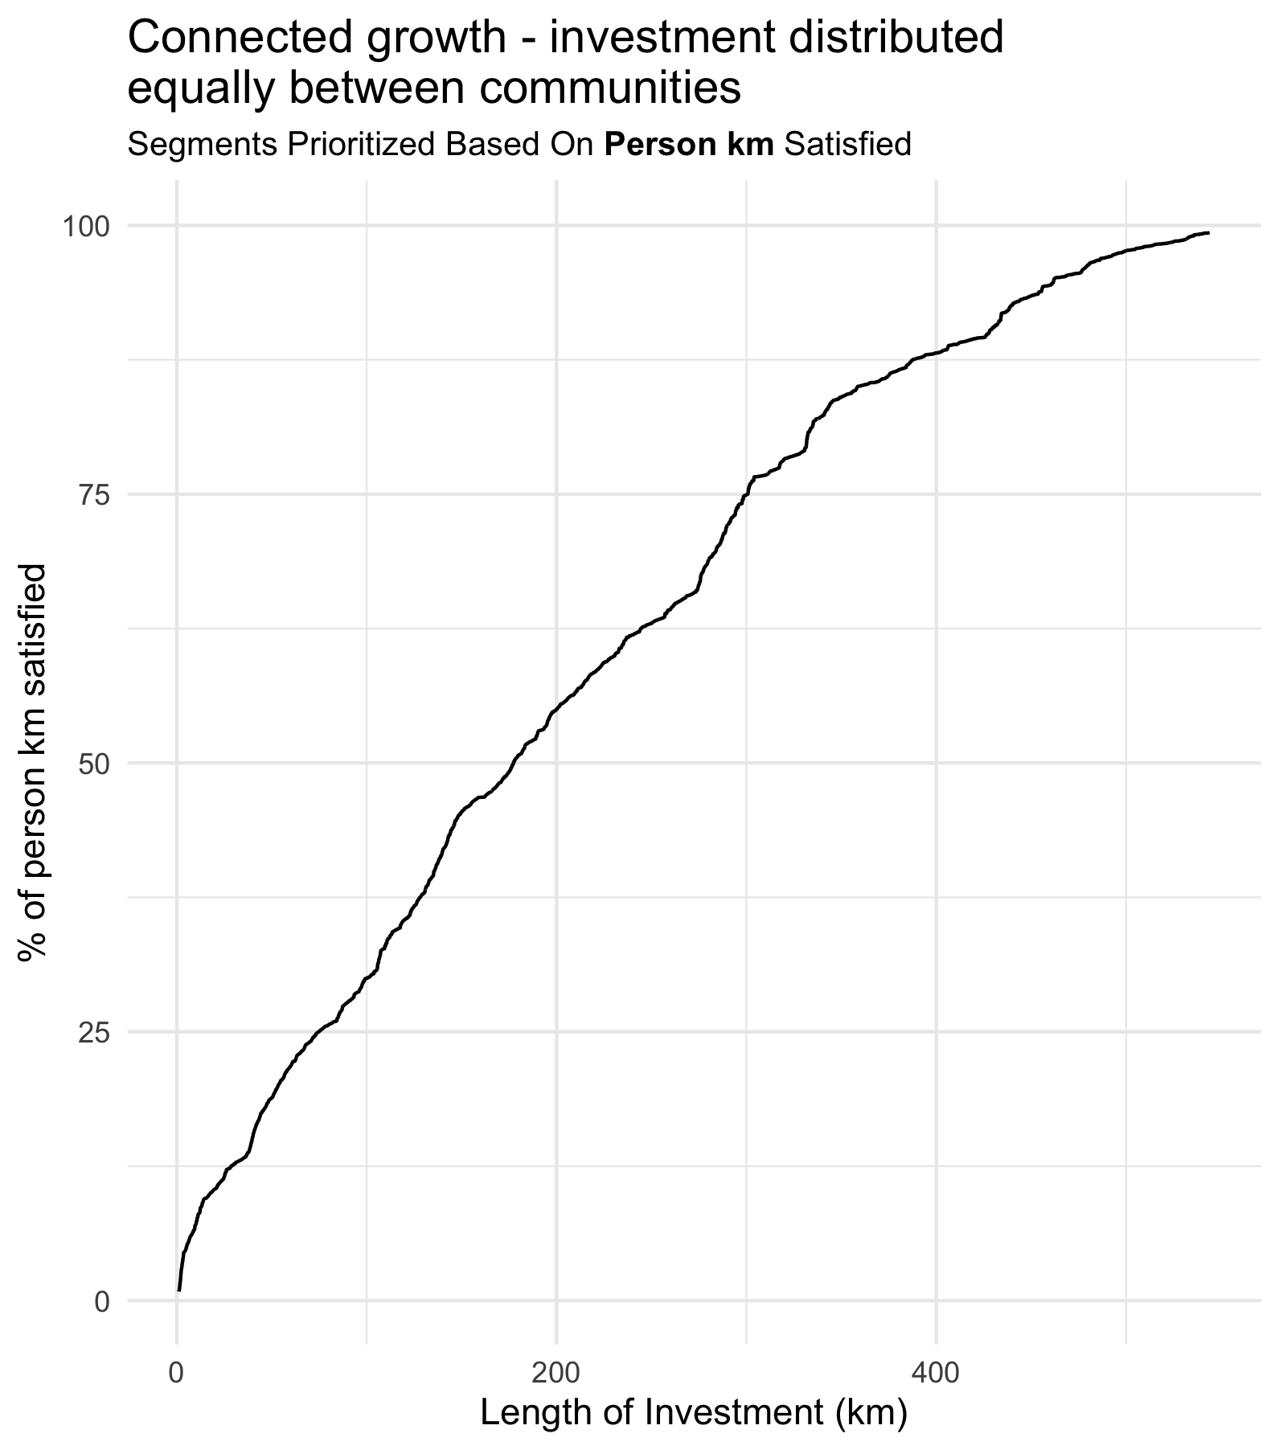

Slide 35
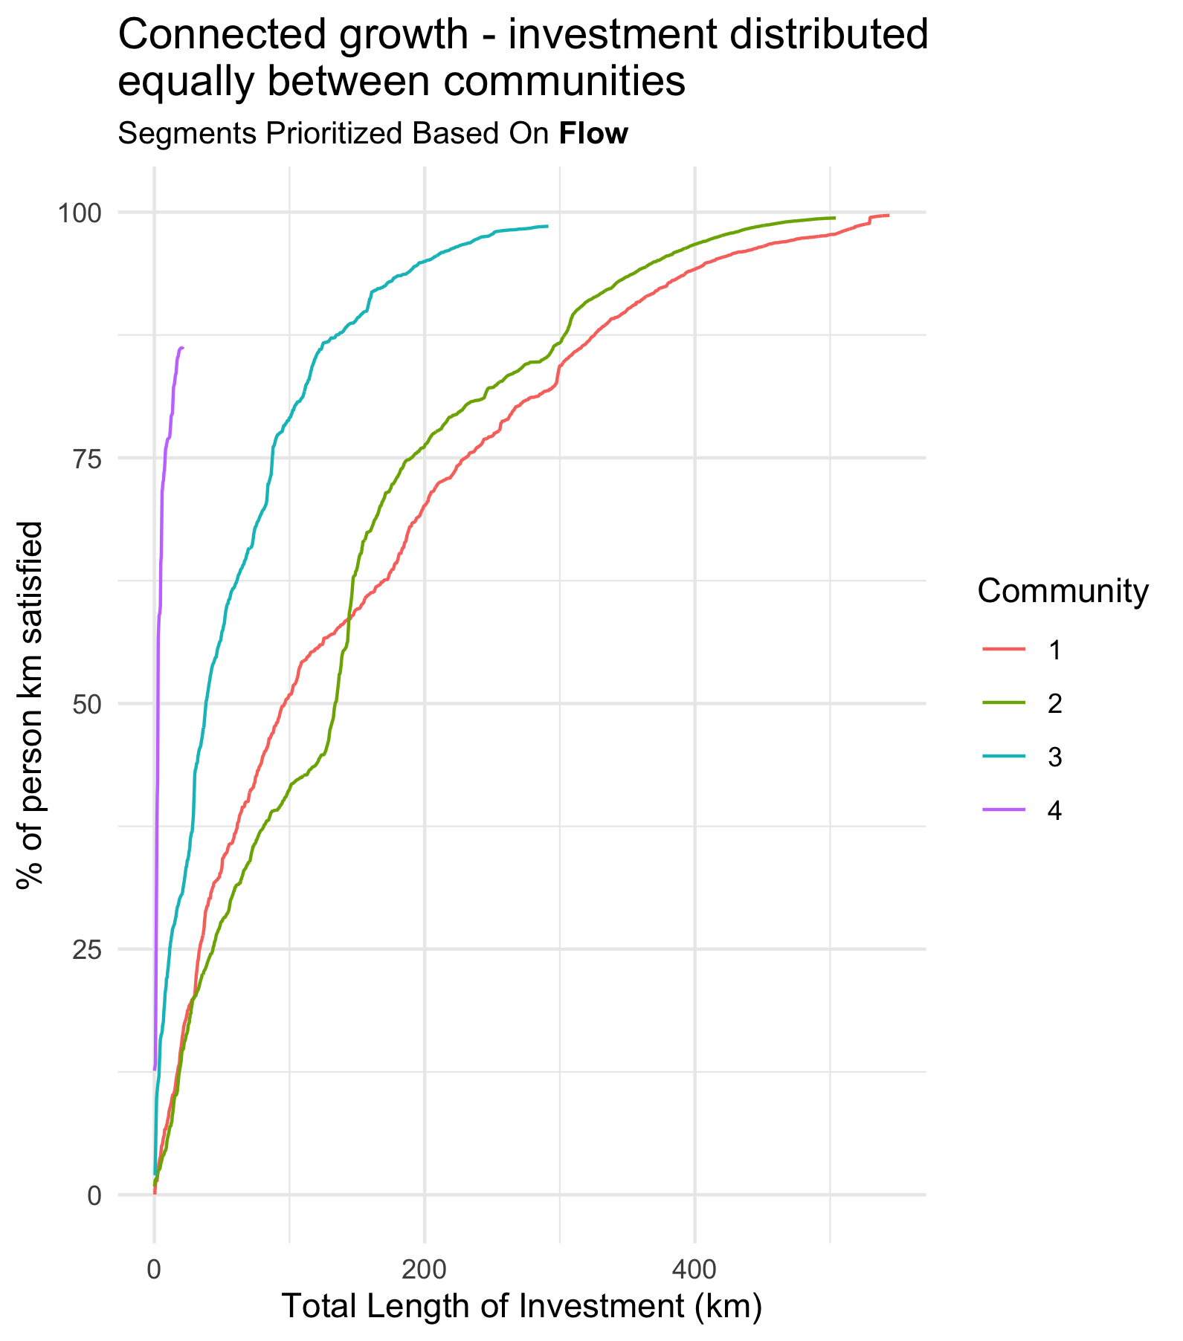
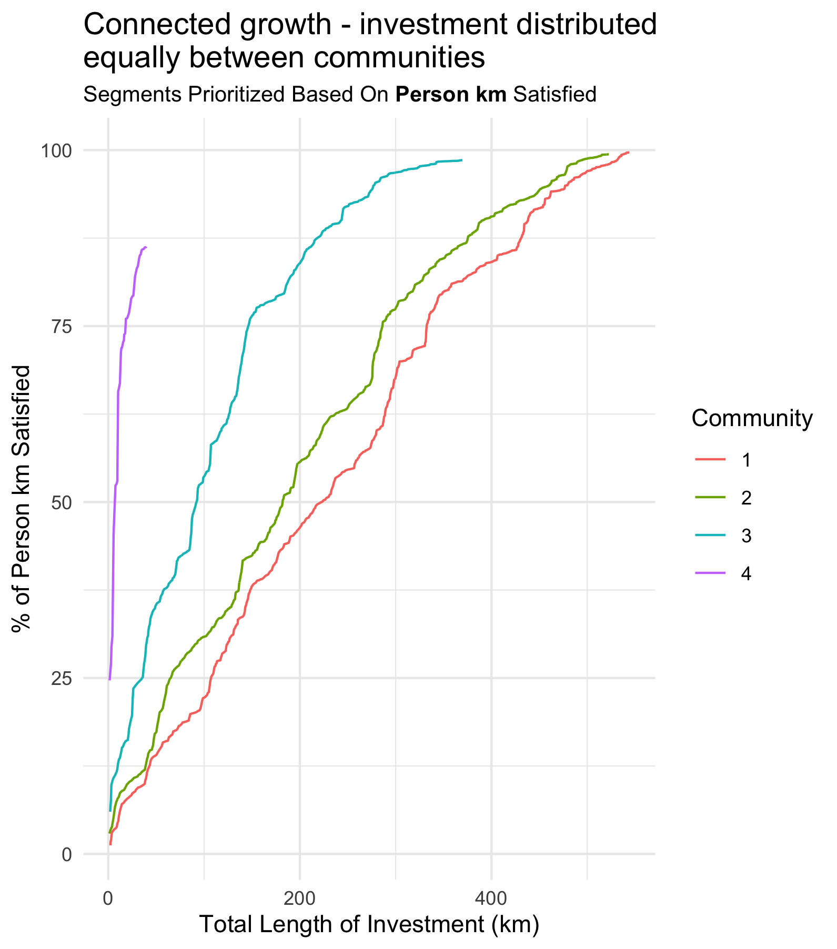

Slide 37
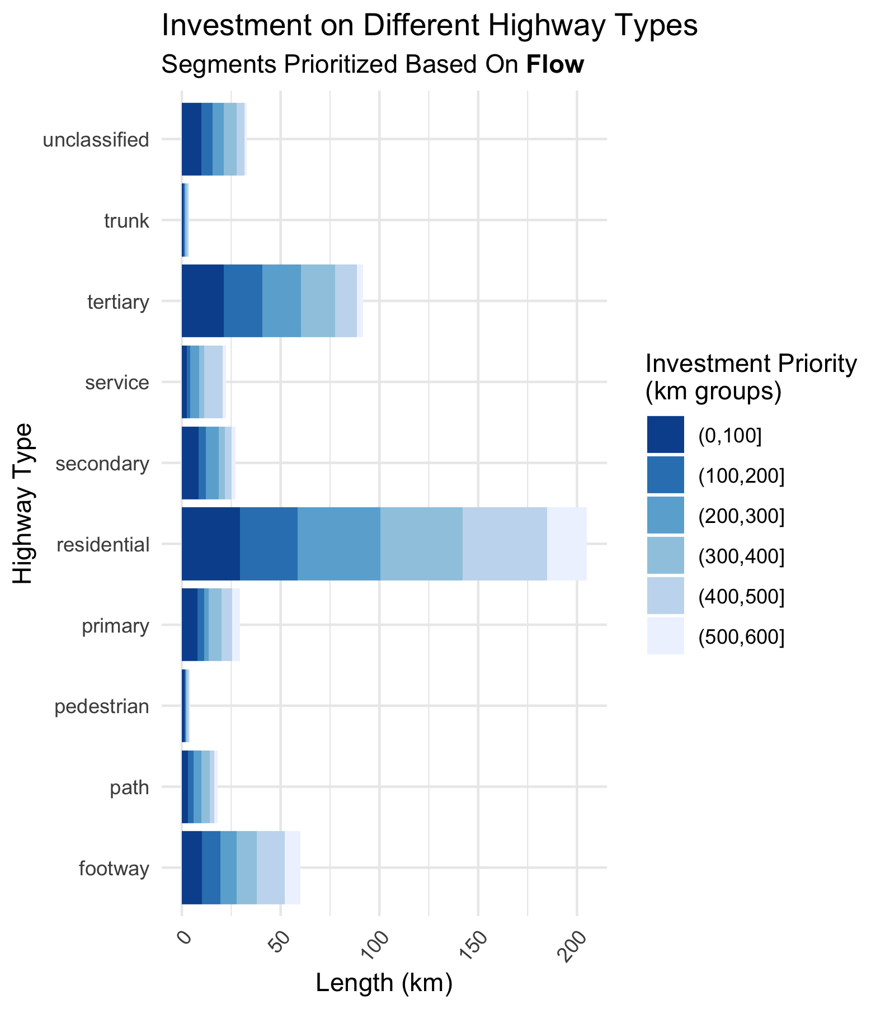
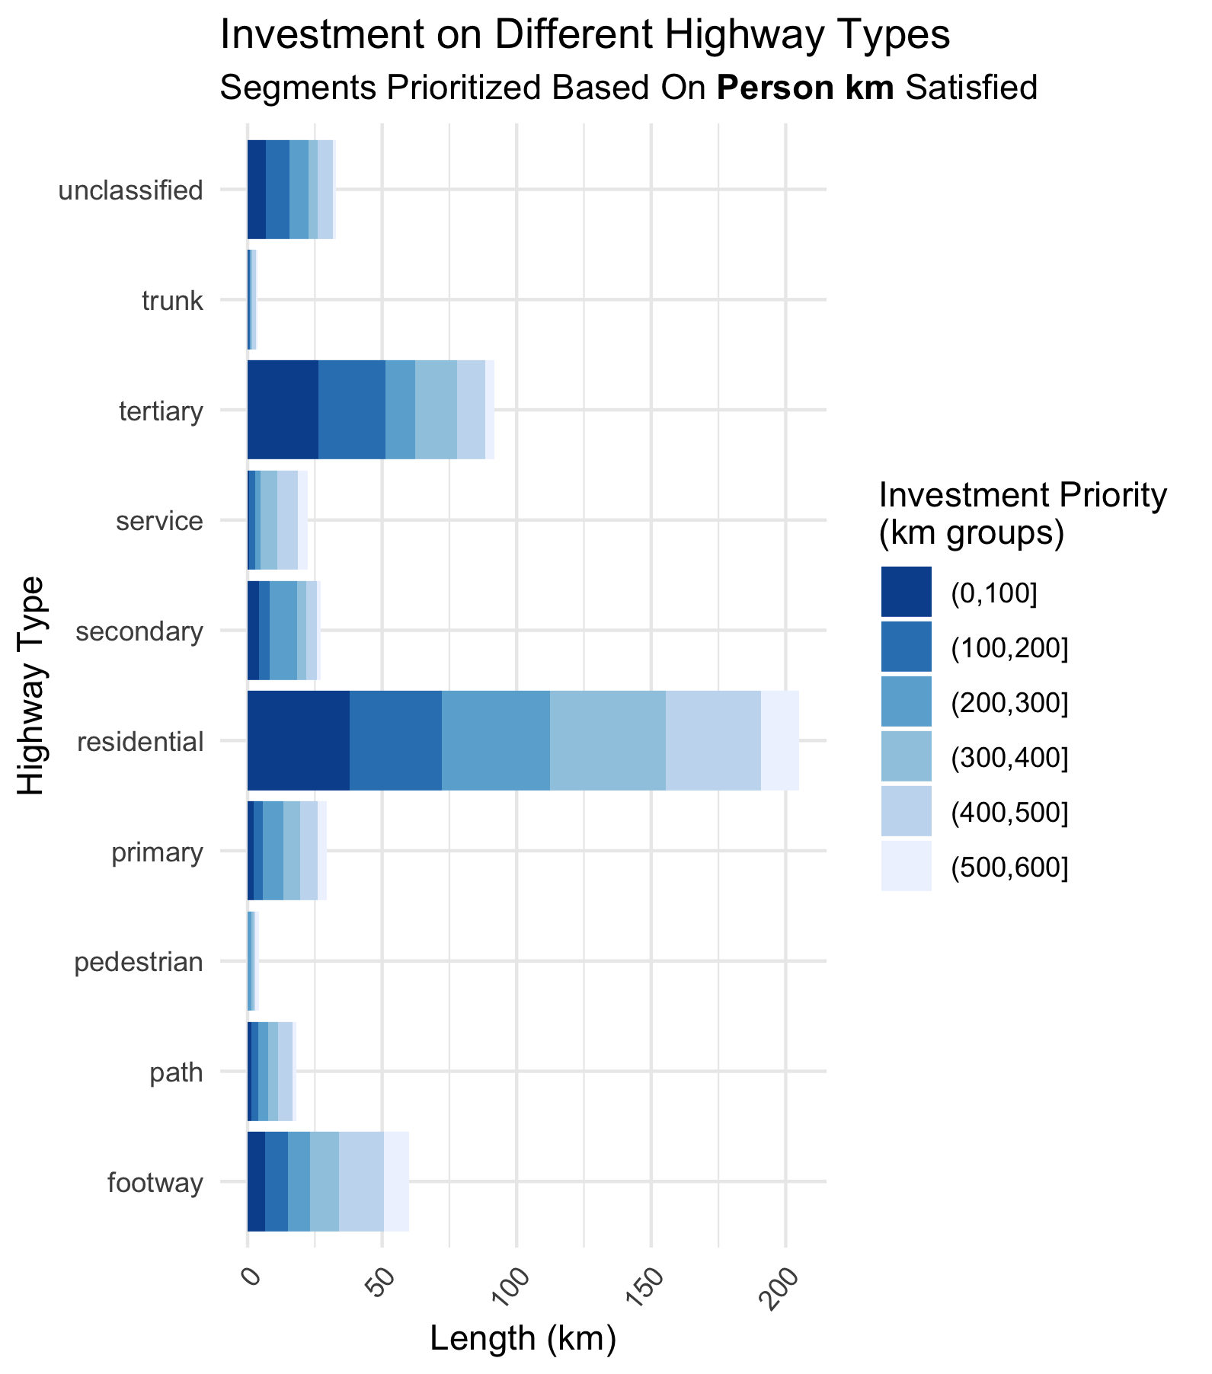

Slide 38
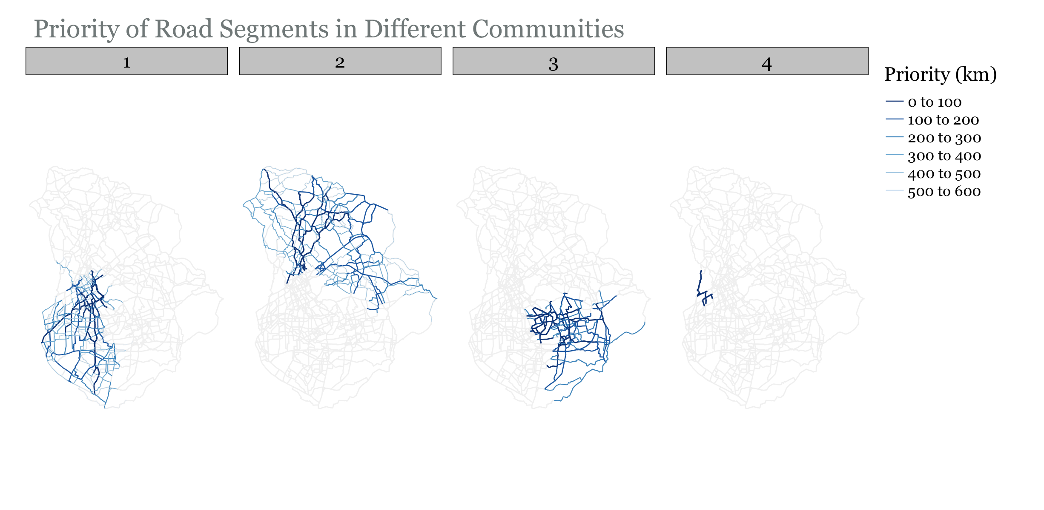

Slide 39
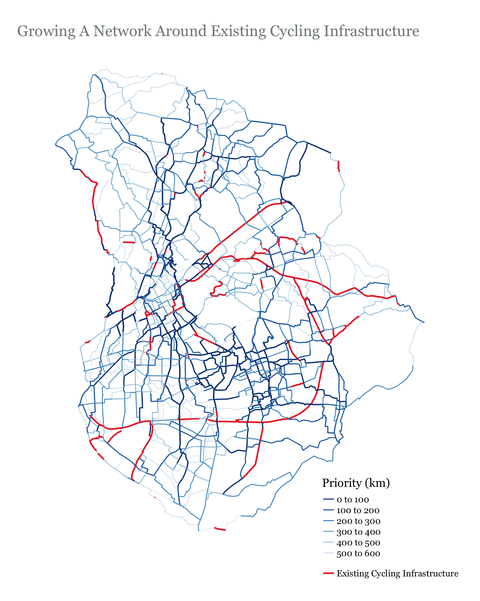

Slide 40
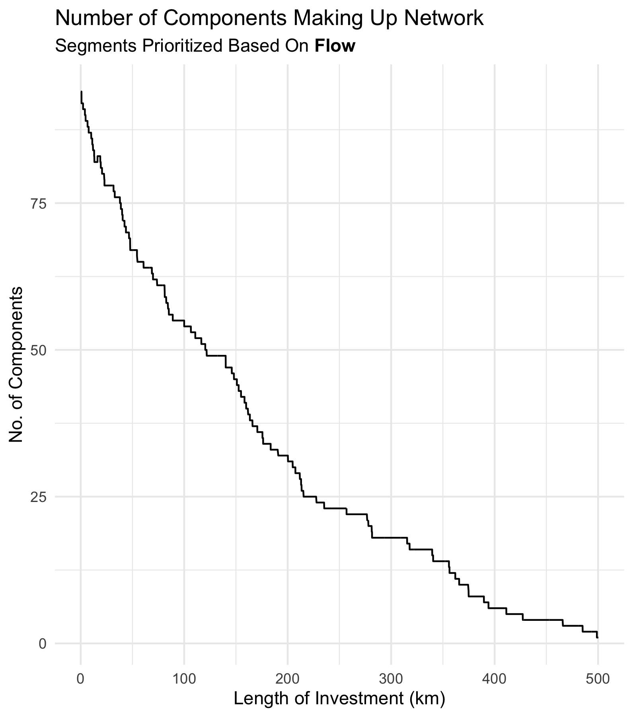
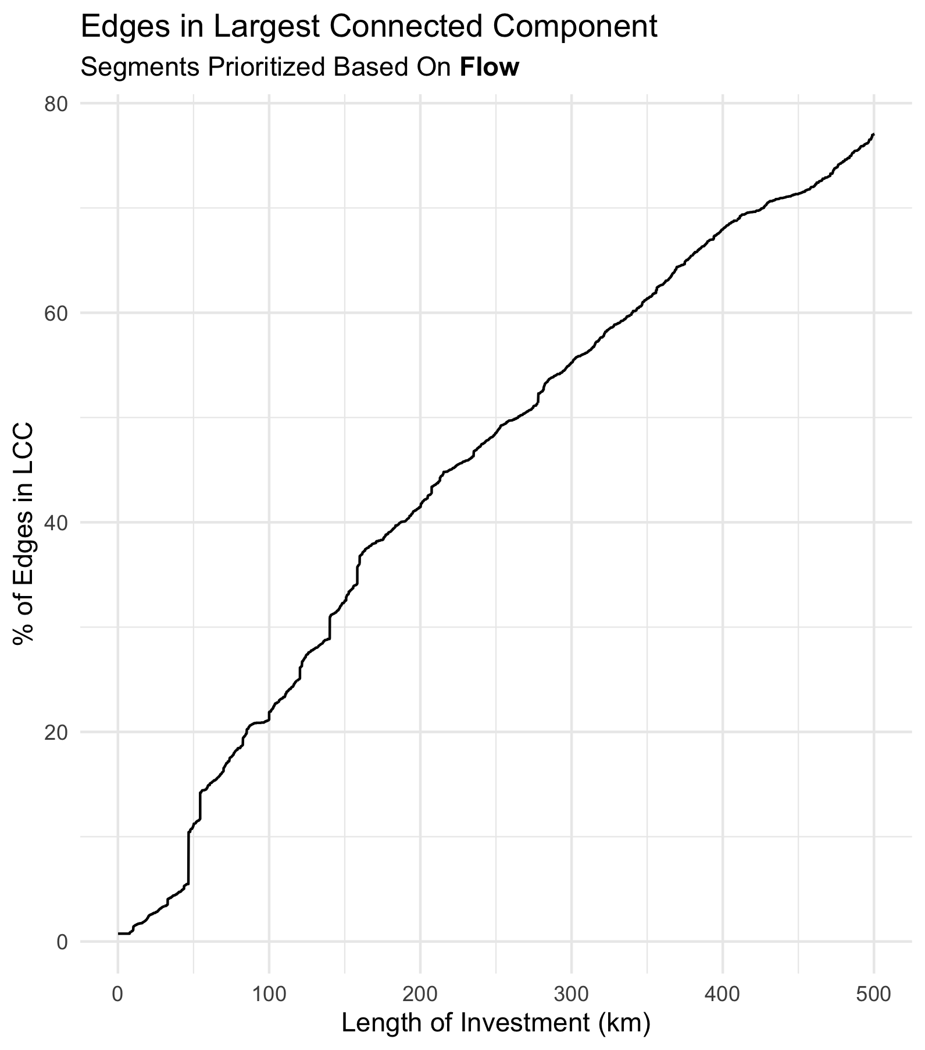

Slide 41
